Slide 1

Trauma and Race Within Human Trafficking:
The Power to Heal
#ISCORE2023
Notes:
Insert session title and presenters names on this slide

Slide 2
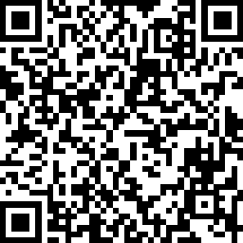
Check
In:
#ISCORE2023
Notes:
Do not edit or remove. This slide is for participants to scan and check into the conference if they haven’t done so already.

Slide 3

NCORE-ISCORE Mission
The NCORE-ISCORE Project supports Iowa State University’s diversity efforts. The project provides positive interactions and dialogue regarding race, ethnicity, and multicultural relations through local and national initiatives, including participation in two conferences: NCORE (National Conference on Race & Ethnicity) and ISCORE (Iowa State Conference on Race & Ethnicity).
#ISCORE2023
Notes:
Do not edit or remove

Slide 4
Land Acknowledgement
We would like to begin this event with a land acknowledgment. Iowa State University is located on the ancestral lands and territory of the Baxoje (bah-kho-dzhe), or Ioway Nation. The United States obtained the land from the Meskwaki and Sauk nations in the Treaty of 1842. We wish to recognize our obligations to this land and to the people who took care of it, as well as to the 17,000 Native people who live in Iowa today.
#ISCORE2023
Notes:
Do not edit or remove

Slide 5

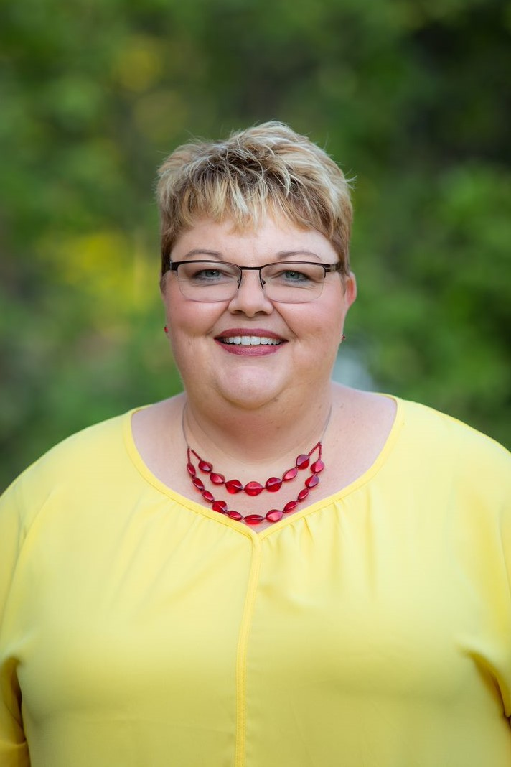
Michelle Roling, LMHC, CEDS-S S
    Assistant Director of Outreach
    Student Counseling Services
#ISCORE2023
Notes:
Use this slide to introduce presenters and add photos, if desired

Slide 6
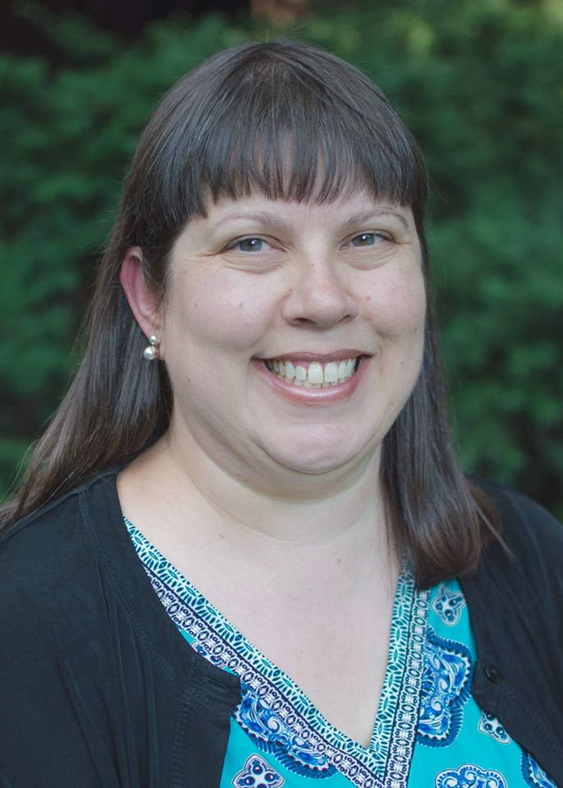
Alissa Stoehr, Ph.D.
    Associate Teaching Professor
    Women’s and Gender Studies and
    Sociology
#ISCORE2023
Notes:
Use this slide to introduce presenters and add photos, if desired

Slide 7

Objectives:
Have a basic understanding of the relationship between
trauma and sex trafficking and how this affects resilience
List four components in your own life which will help
anchor you toward healing and hope
#ISCORE2023
Notes:
This template can be used for a majority of your content. Duplicate as necessary.

Slide 8

Today’s topic…
Challenging
SELF-CARE
  Take a Break
  Step out
  Stand or Stretch
Therapist available
#ISCORE2023
Notes:
This template can be used for a majority of your content. Duplicate as necessary.

Slide 9
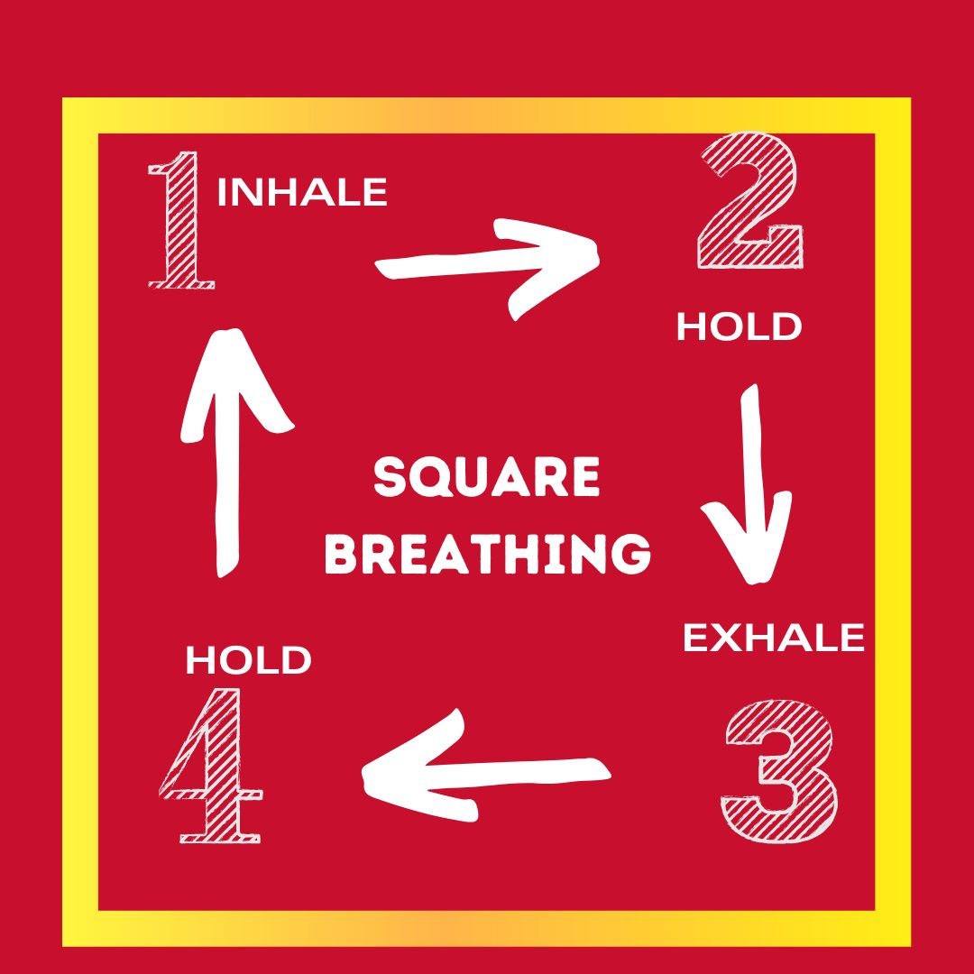






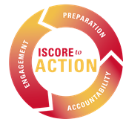
Notes:
Let's take a moment to ground into this time together.

Slide 10
What we know…
Evolving collaboration between researchers, scientists, neurobiologists, and psychologists have resulted in our current understanding of trauma’s impact on us emotionally, physically, and genetically.
#ISCORE2023
Notes:
This template can be used for a majority of your content. Duplicate as necessary.

Slide 11
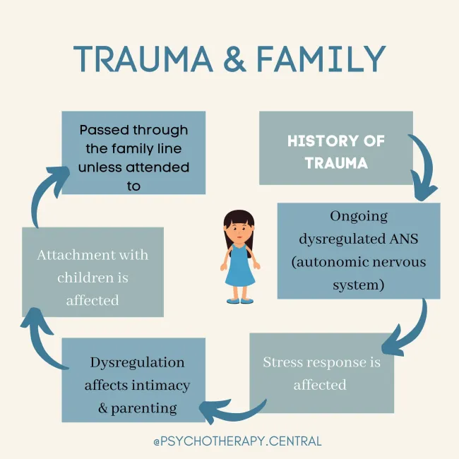


Slide 12
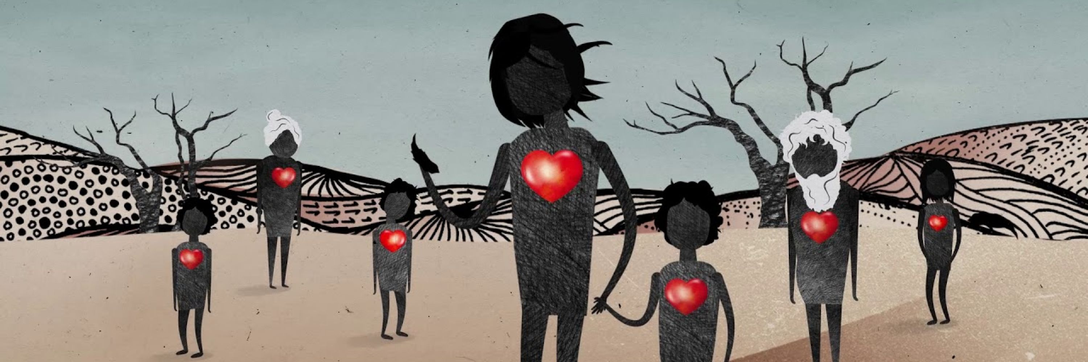
Epigenetics
#ISCORE2023
Notes:
Epigenetics tells the story of how our lived experiences and the environmental lifestyle
we live change the way our DNA and genetic traits. These traits are passed down intergenerationally.
Genes are the blueprint that provide instructions for making proteins in our bodies. All processes that make us human require these proteins and help to define who we are. Epigenetics describes the way that our genes are turned on and off – whether a specific gene is used or not. We now know that what we experience in life changes our epigenetic profile, or in other words, life experience changes our genes – really getting under our skin. Not only does this affect the individual, the way our bodies respond to stress can be passed from one generation to the next through our genes.

Slide 13
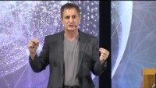
Notes:
Youtube clip Author- It didn't start with you. Mark Wolynn

Slide 14
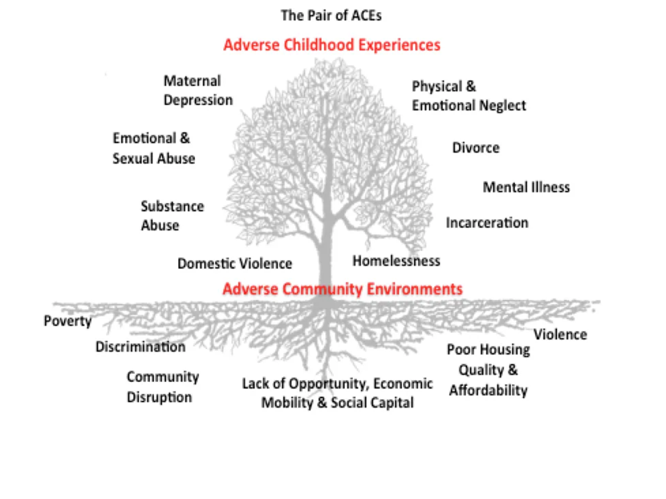
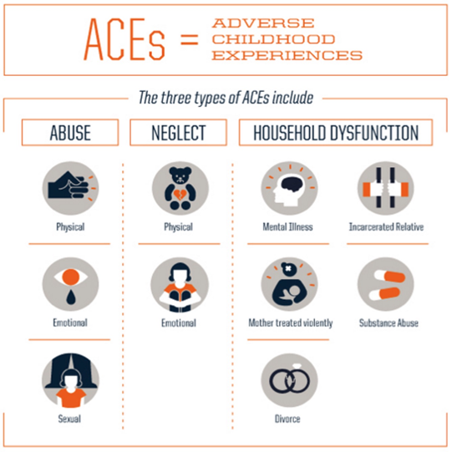
#ISCORE2023
Notes:
1998 10 questions designed to help pediatricians predict/ intervene on behalf of patients The CDC-Kasier ACE study found that adults with an ACE score of 4 or more were at significantly greater risk for many behavioral, physical, and mental health issues later in life.

Slide 15
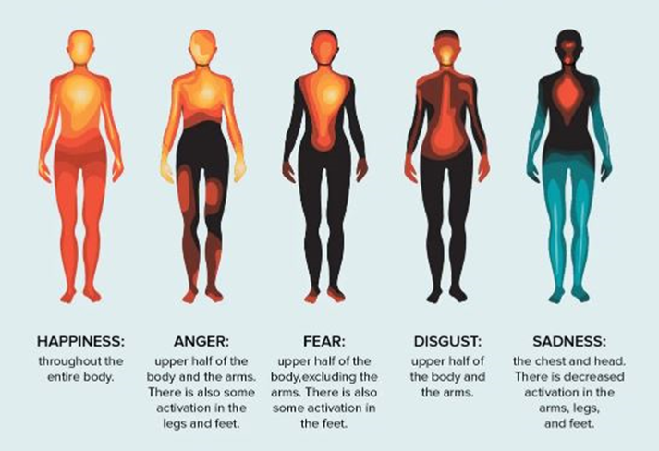
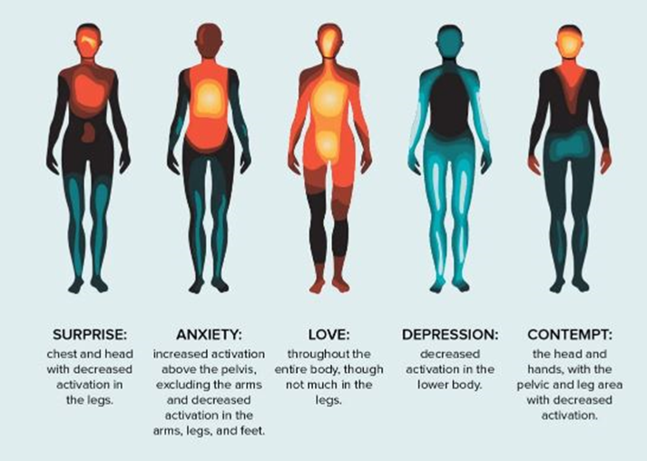
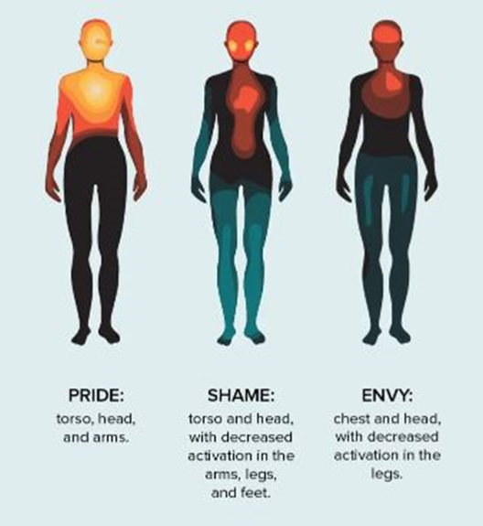
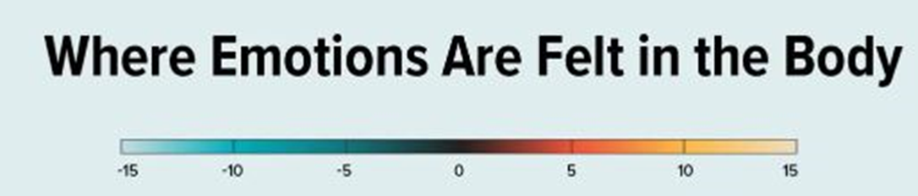

Slide 16
What is Polyvagal Theory?
How is it connected to the Anatomic Nervous System?
#ISCORE2023
Notes:
We will discuss the process of skill building to ‘hear’ our central nervous system and how this “in the moment” insight can move us toward emotional and physical healing.

Slide 17
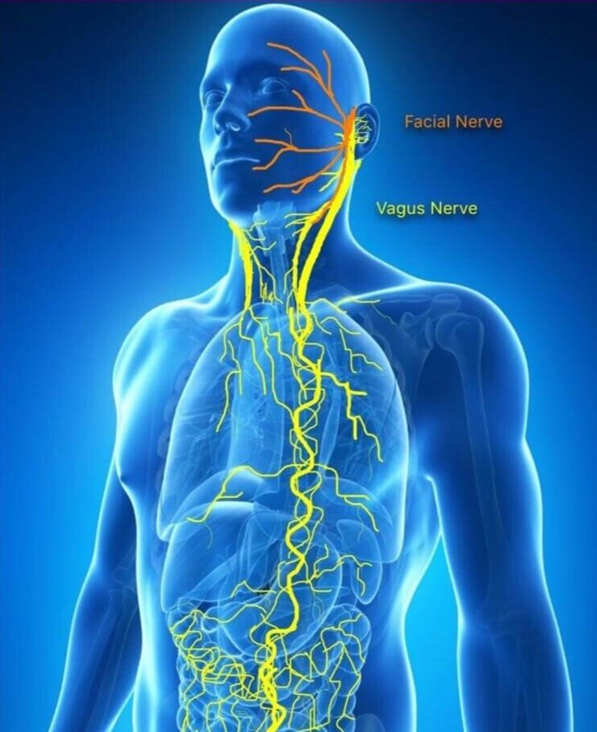
Polyvagal Theory and​
Anatomic Nervous System
Ventral Vaga
Sympathetic Vaga
Dorsal Vaga
Notes:
The Polyvagal Theory, proposed by Stephen Porges, describes how the mammalian autonomic nervous system evolved to keep us safe and alive

Slide 18
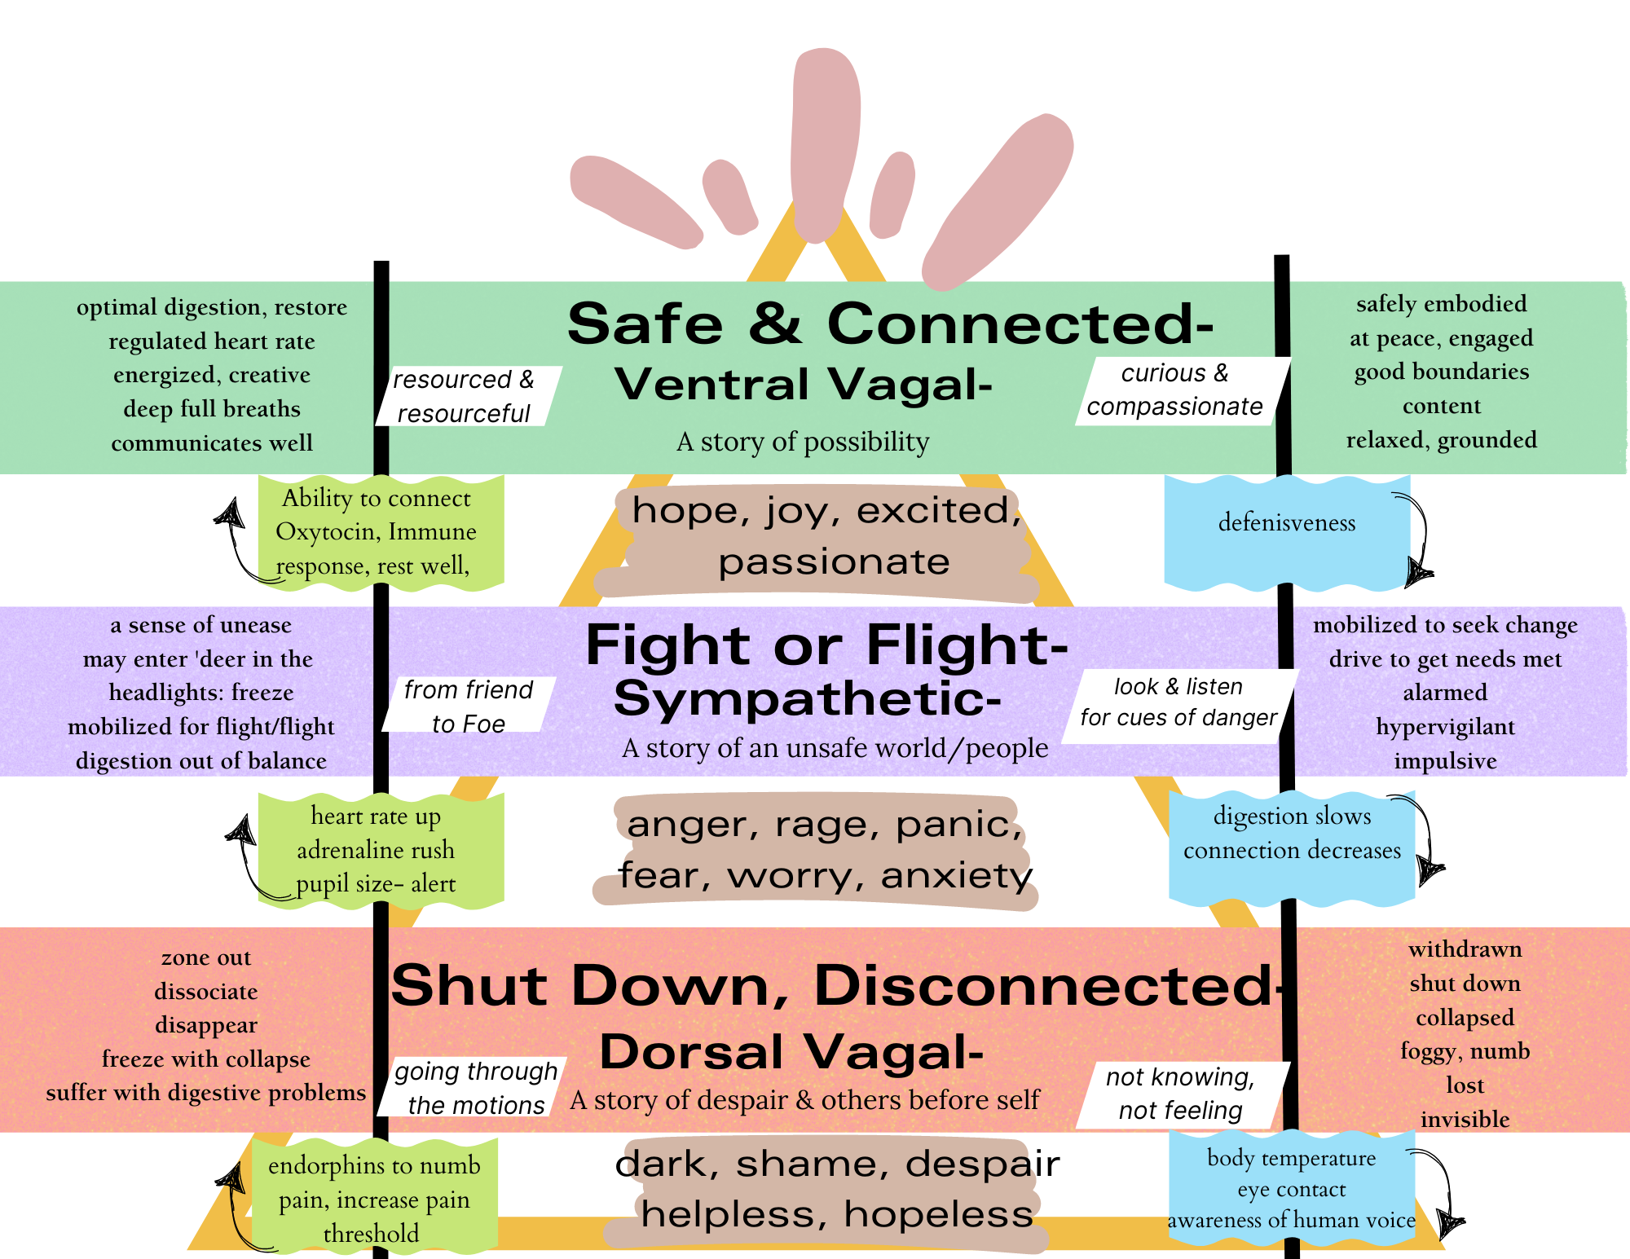

Slide 19
Food Insecurity
& Generational
Trauma
For example, science demonstrates that when one generation is food insecure, the next four generations of the family will struggle with ‘unexplained’ food worries, despite an abundance of food.
#ISCORE2023
Notes:
This template can be used for a majority of your content. Duplicate as necessary.

Slide 20
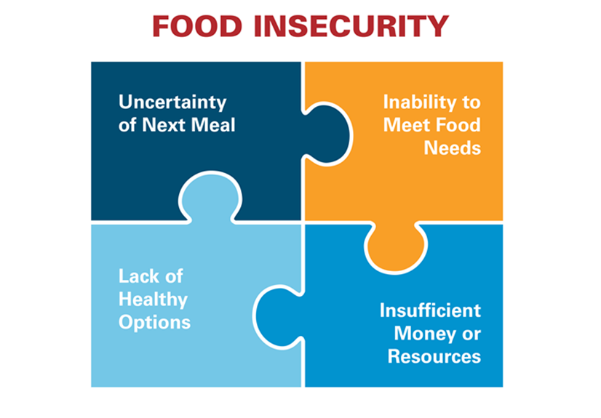
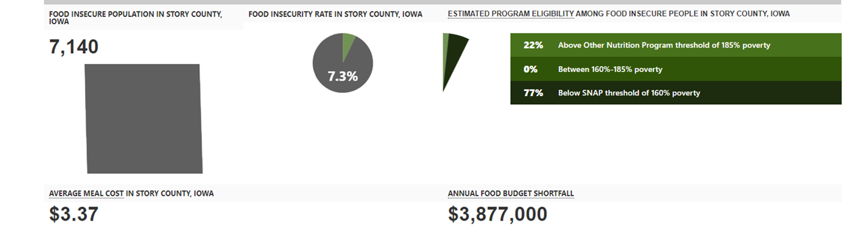

Slide 21
Trauma
One of the most significant traumas imaginable is human trafficking.
#ISCORE2023
Notes:
This template can be used for a majority of your content. Duplicate as necessary.

Slide 22
Sex Trafficking
Legal definition: Sex trafficking is the recruitment, harboring, transportation, provision, obtaining, patronizing, or soliciting of a person for the purpose of a commercial sex act in which a commercial sex act is induced by force, fraud, or coercion, or in which the person induced to perform such act has not attained 18 years of age. (22 U.S.C. § 7102(11)(A)).
Human trafficking occurs when a trafficker takes any one of the Actions, and then employs the Means of force, fraud or coercion for the Purpose of compelling the victim to provide commercial sex, labor, and/or services
Research demonstrates individuals with intersecting identities such as female and BIPOC (Black, Indigenous and People of Color) are at greatest risk of being trafficked.
#ISCORE2023
Notes:
This template can be used for a majority of your content. Duplicate as necessary.

Slide 23
Human Trafficking Statistics
2008-2010 United States Department of Justice Report
Review of human trafficking cases
  94% of sex trafficking victims were female
    40% were Black and 24% were Latinx
Native American women in South Dakota
    40% of sex trafficking victims, but only represent 8% of the total population
New Mexico Native American women
    25% of sex trafficking victims, but only represented 11% of total population
  Most of labor trafficking victims were undocumented migrants
    63% were Latinx and 17% were Asian
#ISCORE2023
Notes:
This template can be used for a majority of your content. Duplicate as necessary.

Slide 24
The Racial Roots of Human Trafficking
Cheryl Nelson Butler
"Race intersects with other forms of subordination including gender, class, and age to push people of color disproportionately into prostitution and keep them trapped in the commercial sex industry. Its intersectional oppression is fueled by the persistence of myths about minority teen sexuality, which in turn encourages risky sexual behavior." (Butler, 2015)
#ISCORE2023
Notes:
This template can be used for a majority of your content. Duplicate as necessary.

Slide 25
The Racial Roots of Human Trafficking
Cheryl Nelson Butler
"While Black children are more likely to experience some form of sex trafficking, other children of color are similarly at a higher risk than their White counterparts. Native Americans, in particular, argue that a strong connection exists between colonization and a persistent targeting of native people for prostitution." (Butler, 2015)
#ISCORE2023
Notes:
This template can be used for a majority of your content. Duplicate as necessary.

Slide 26
The Racial Roots of Human Trafficking
Cheryl Nelson Butler
"Any vulnerable child can be a victim of sex trafficking, but we can no longer gloss over the fact that the majority of those who are victimized are girls of color. By illuminating the problem and potential solutions, we are taking the first steps toward ending the abuse and exploitation of our most marginalized girls...The first step is to have compassion for the pain, the discrimination, and the trauma these girls have experienced..." (Gabrielle Union, 2020)
#ISCORE2023
Notes:
This template can be used for a majority of your content. Duplicate as necessary.

Slide 27
Race and Human Trafficking:
How This Crime Disproportionately Affects Ethnic Minorities and Indigenous Persons
(Paiz & Van Schooneveld, 2022)
BiPOC are more likely to experience:
  Poverty
  Involvement in the foster care system
  Unstable care environments
  Homelessness
  Systemic racism
  Historical oppressions
*These are the same vulnerabilities that are exploited by traffickers.
#ISCORE2023
Notes:
This template can be used for a majority of your content. Duplicate as necessary.

Slide 28

How do we heal?
Increasing Personal Resilience
#ISCORE2023
Notes:
This template can be used for a majority of your content. Duplicate as necessary.

Slide 29
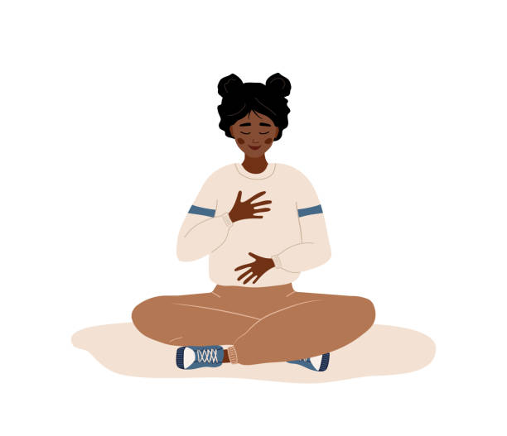
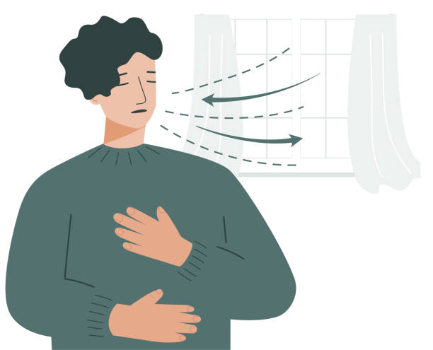
#ISCORE2023
Notes:
These graphics and footer can be used as needed throughout your presentation.

Slide 30


Ventral Vagal
Sympathetic
Dorsal Vagal

Slide 31
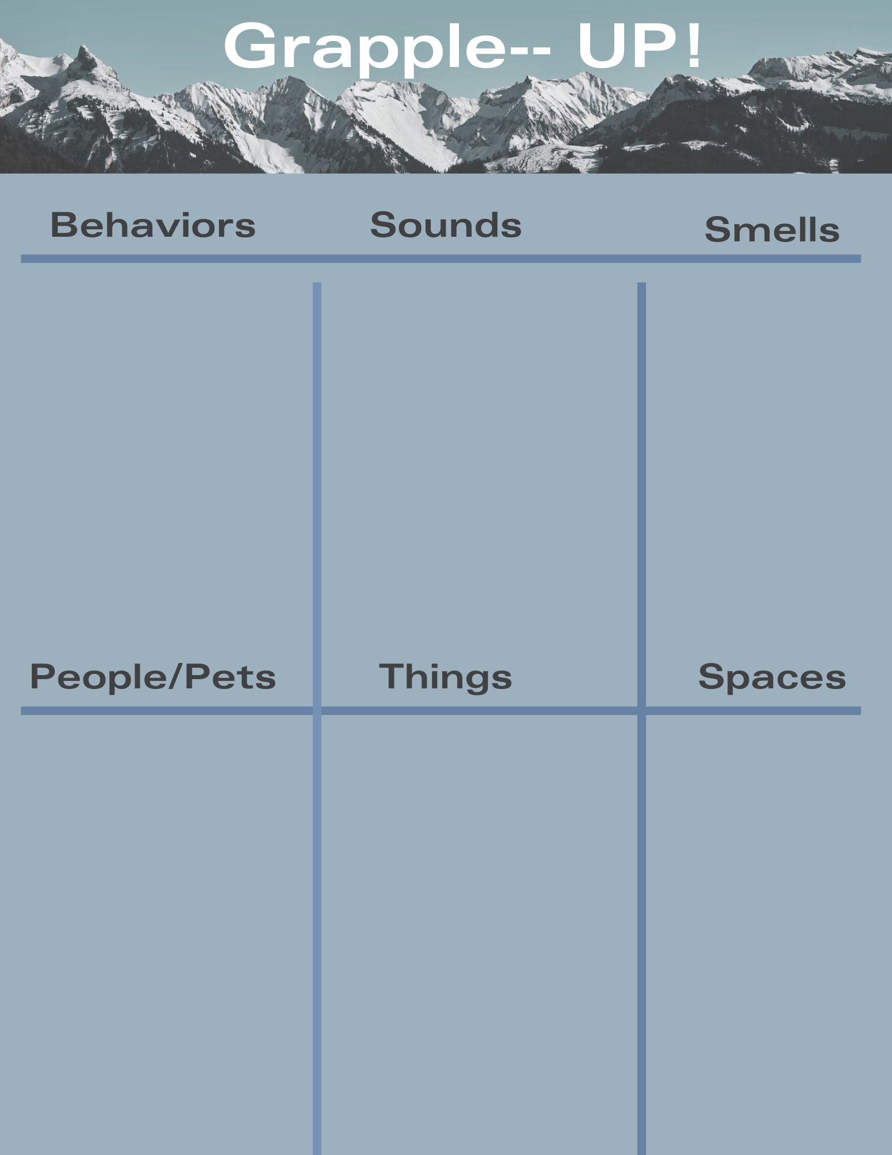

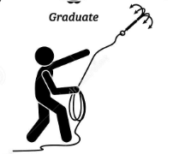

Slide 32
RESOURCES
#ISCORE2023
Notes:
This template can be used for a majority of your content. Duplicate as necessary.

Slide 33


Slide 34
Resources
•National Human Trafficking Hotline: 1-888-373-7888 (answered 24/7/365 in over 200 languages)
•ACCESS (www.assaultcarecenter.org)
•Garden Gate Ranch (www.gardengateranch.com)
•Wings of Refuge (www.wingsofrefuge.net)
•Lila Mae’s House (https://lilamaeshouse.org/)
•Dorothy’s House (https://dorothyshouse.org/)
•The Set Me Free Project (www.setmefreeproject.net)
•Polaris Project (www.polarisproject.org)
•ISU Network Against Human Trafficking and Slavery (https://www.facebook.com/isu.naht)
•Iowa Network Against Human Trafficking and Slavery (www.iowanaht.org)
•WGS/SOC 410/510: Human Trafficking (offered Fall 2023)
•Human Trafficking Honors Seminar (usually offered every semester; next offered Fall 2023)
#ISCORE2023
Notes:
This template can be used for a majority of your content. Duplicate as necessary.

Slide 35

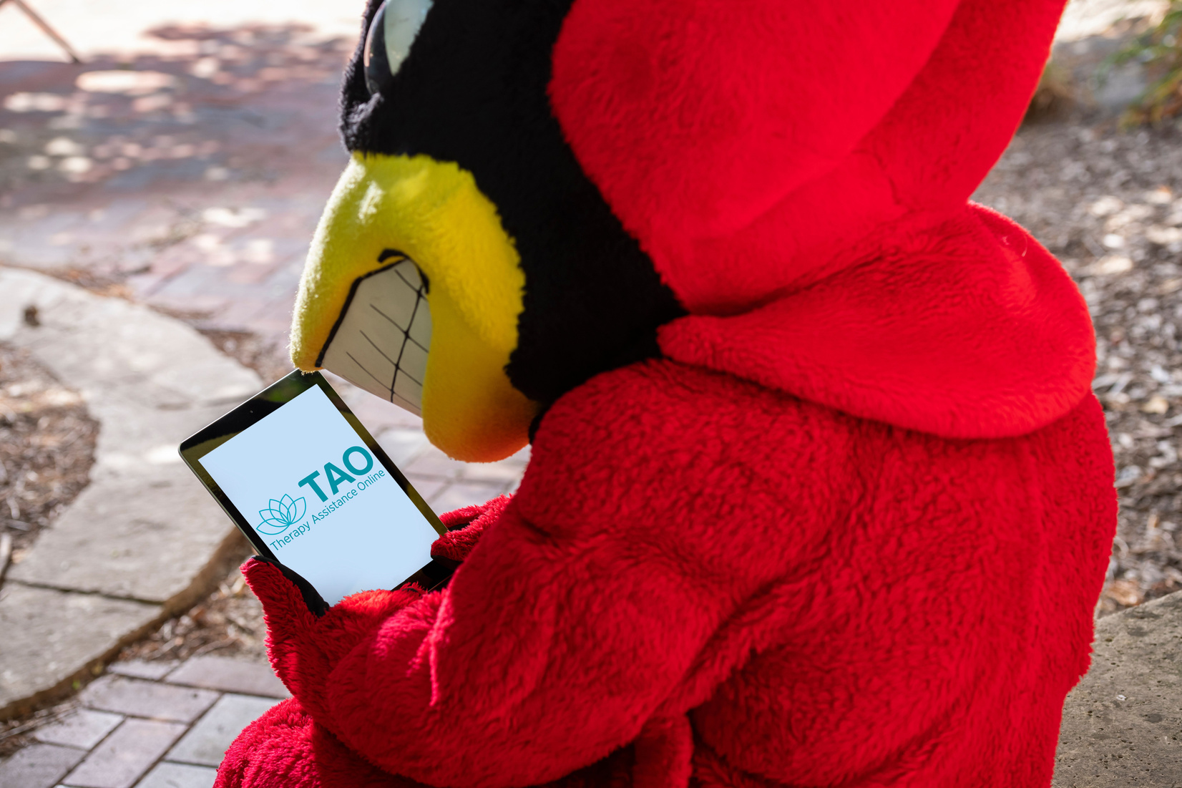




Therapy Assistance Online
FREE
with your ISU email address
Notes:
Therapy Assistant online is an amazing free resource that everyone with an Iowa State email address has access to this system is an application you can use on a computer or on a smartphone and has thousands of activities that range from being able to shift your thinking patterns through cognitive behavior therapy relaxation and mindfulness skills around communication and relationships finances perfectionism it is an amazing resource you have access to 24 hours a day 365 days a year

Slide 36


#ISCORE2023
Notes:
This template can be used for backgrounds of photos during your presentation.

