Slide 1
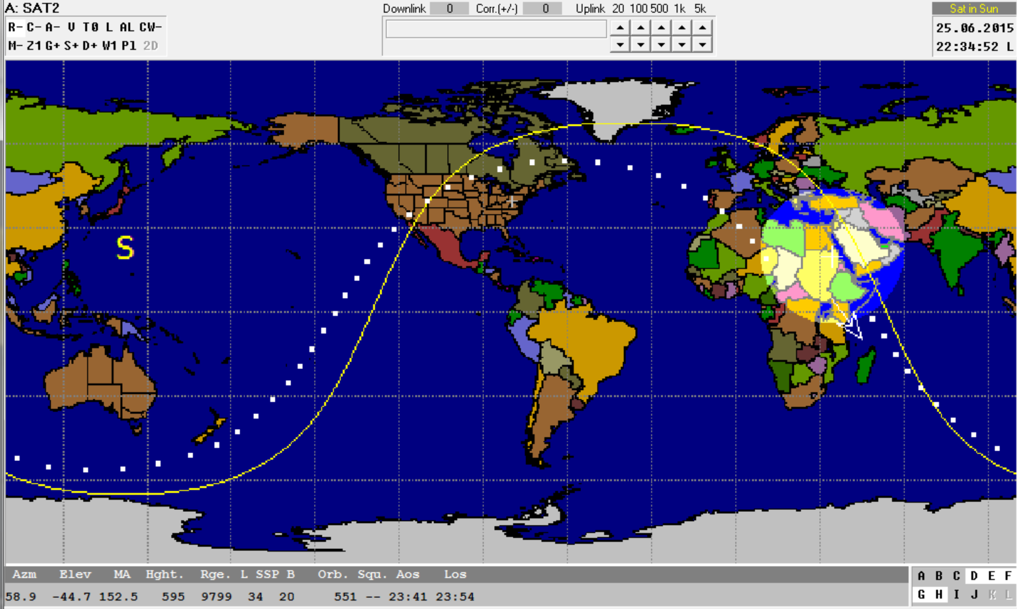
Constellations, Urban Launches, and Water Landings
Hank Voss, Jeff Dailey, Arron Voss, and Bill Bauson
Smaller-Simpler-Significant-Systems: S⁴ balloons
By NearSpace Launch, Inc. and Taylor University Academic High Altitude Conference (AHAC)
June 23, 2015 Pre Conference Workshop

Slide 2
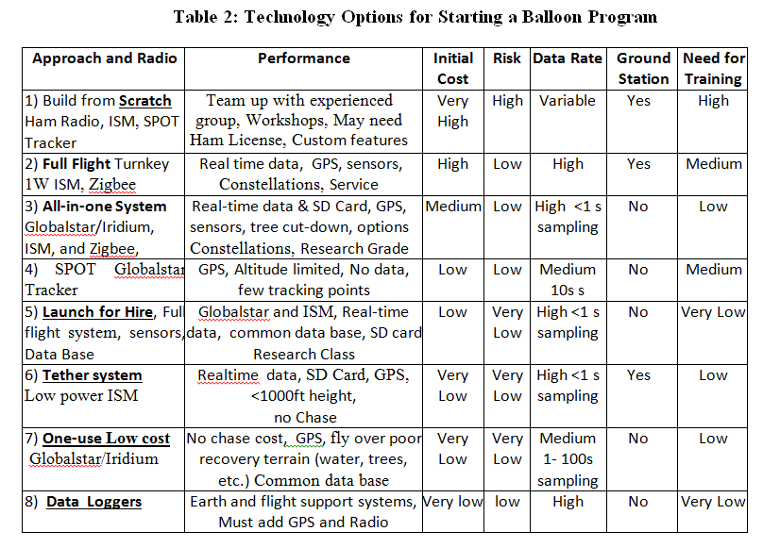

Slide 3
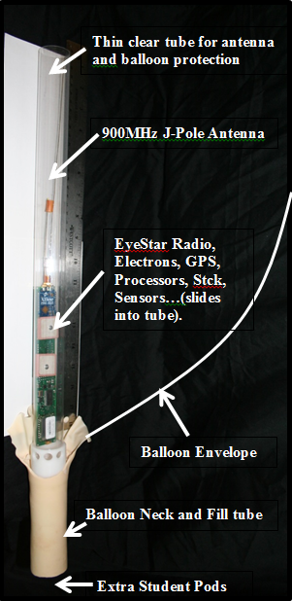
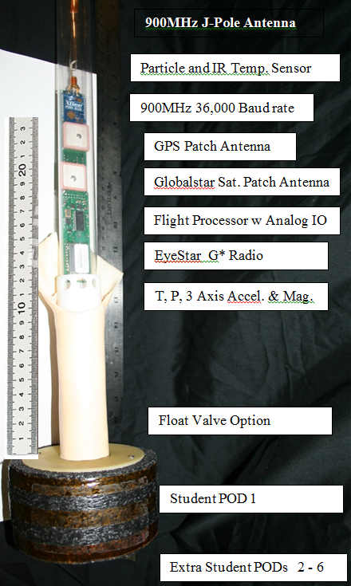
NSL EyePod-Mini: Smaller-Simpler-Significant-Systems: S⁴
Lower Cost
Modular Assembly
Less Turbulence
Protect Antenna
Easy Assembly
Tree Drop
Safety (distributed)
Less perceived risk
900 MHz Link/GPS
GlobalStar Link/GPS
Ham APRS Link/GPS
2GB Memory Stick
Processor
Eight IO lines
3Axis Accelerometer
Pressure
Temperature
Humidity

Slide 4
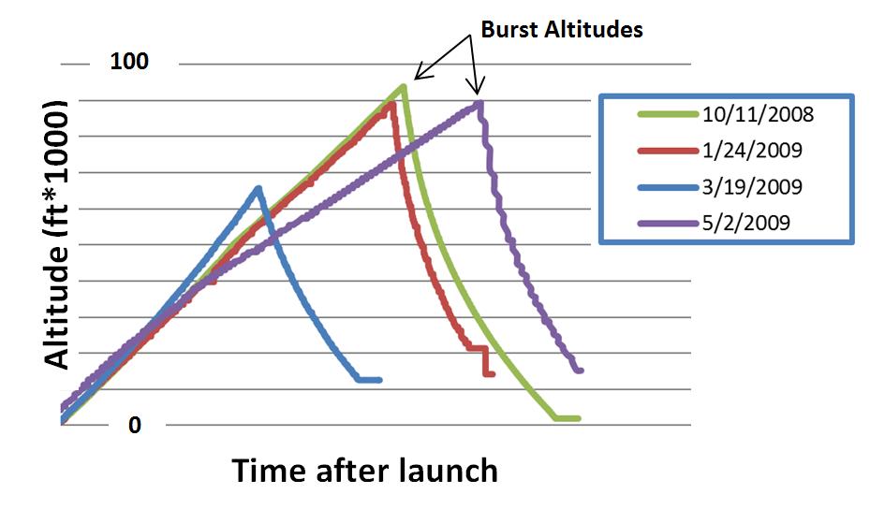
Loss of Descent Profile

Slide 5
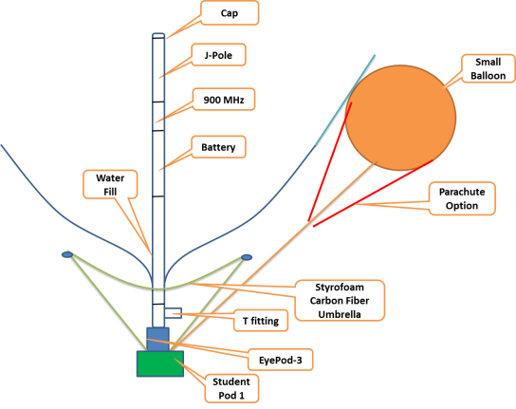

Slide 6
Primary and Secondary Balloons
Problems with one balloon:
Post Burst Chaos, failures, loss of sensors & antenna link, parachute tangle, poor imaging, whiplash,…
Nonlinear descent rate: poor data, loss of half data, comparison of ascent and descent profiles
A Solution:
Two smaller balloons in place of one large balloon
Master-Slave gives complete descent profile for comparison with ascent and is out of the balloon wake
Atmospheric gas collection in evacuated tube coil is possible for gas analysis
Slave balloon floats at landing site (marker) and may be reused.
Parachute not used (backup)

Slide 7
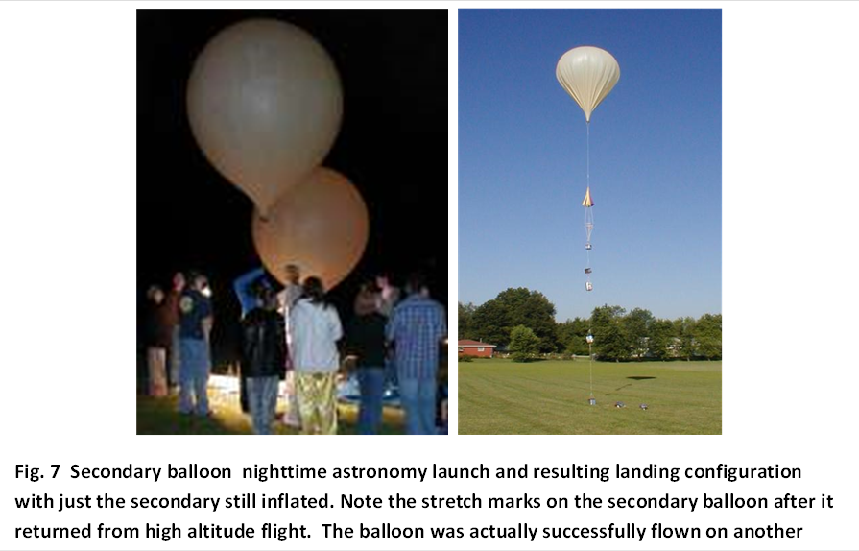

Slide 8
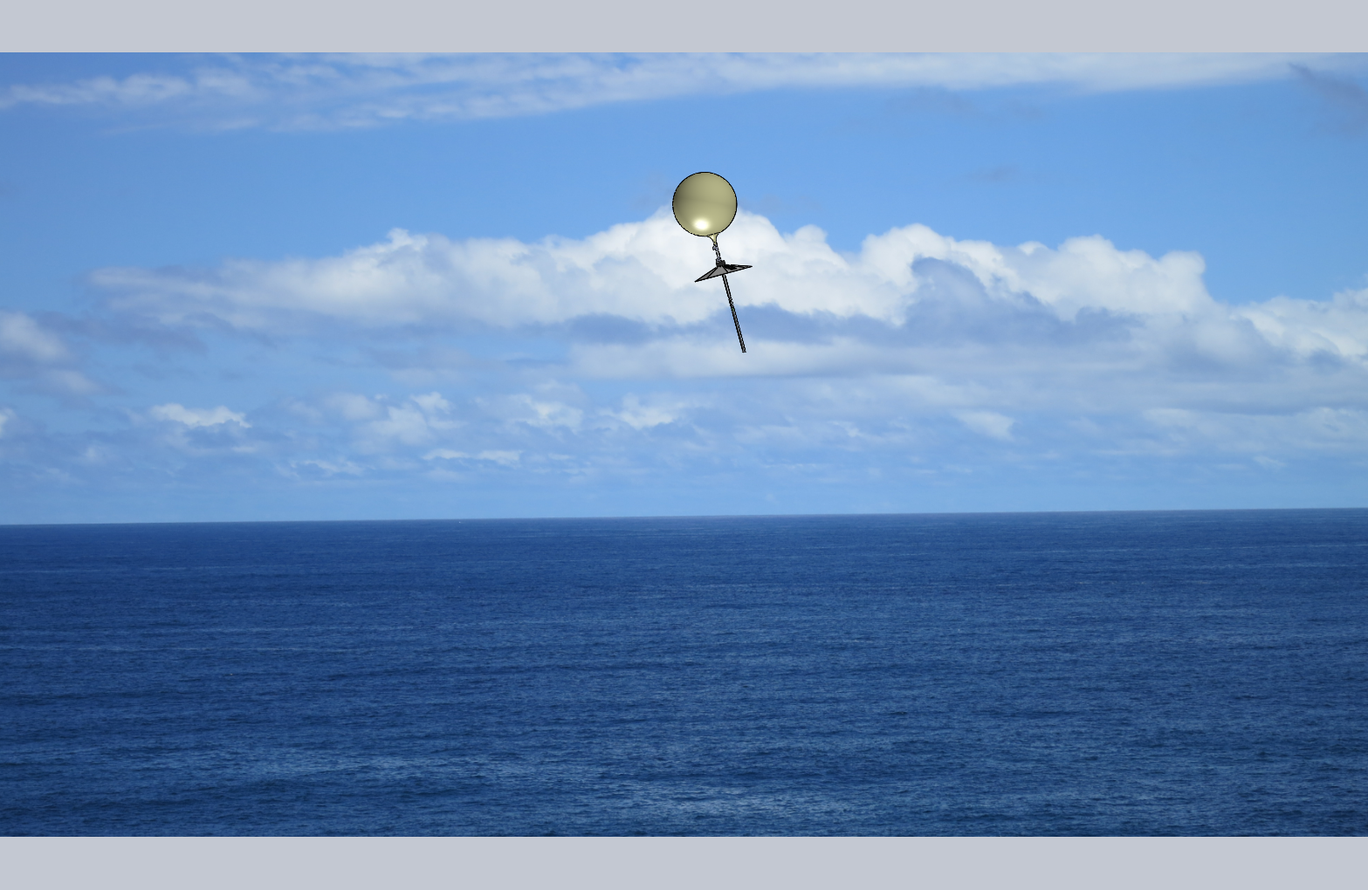
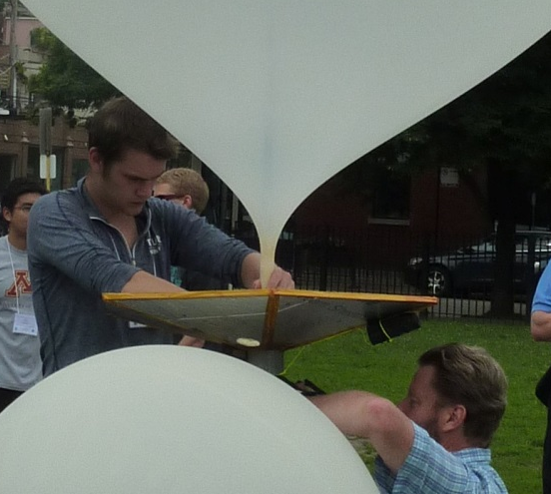
HydroChute
The HydroChute is fixed in shape and is made of foam board material, fiberglass, and aluminum face-sheet. The purpose of the HydroChute is to
Acts as a backup parachute if the secondary balloon also burst,
Helps float the payload in an upright position if landing in water or upright if landing as a ground probe in a remote area,
Acts as a radar reflector for flight for added safety,
Forms the base structure for solar cells to keep the transmitter and sensors powered when floating or as a ground probe,
Acts as the structure for mounting sensors and cameras to collect experiment data, and
Is a platform that is fixed to the balloon for less rotation and pendulum motion relative to the cable tethered pods.

Slide 9
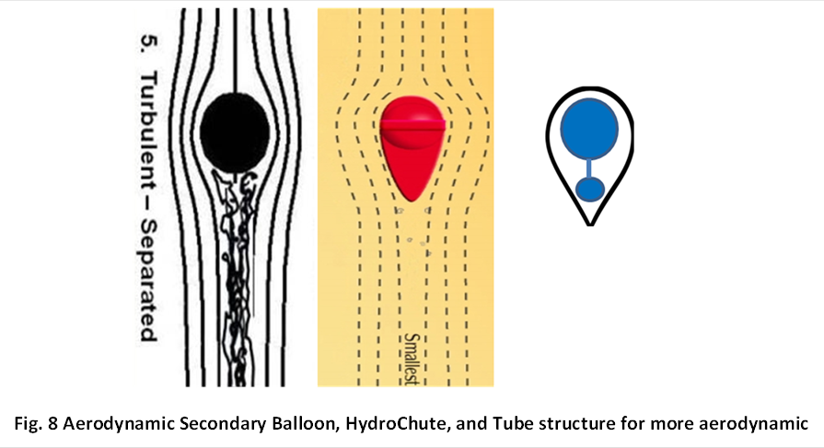

Slide 10
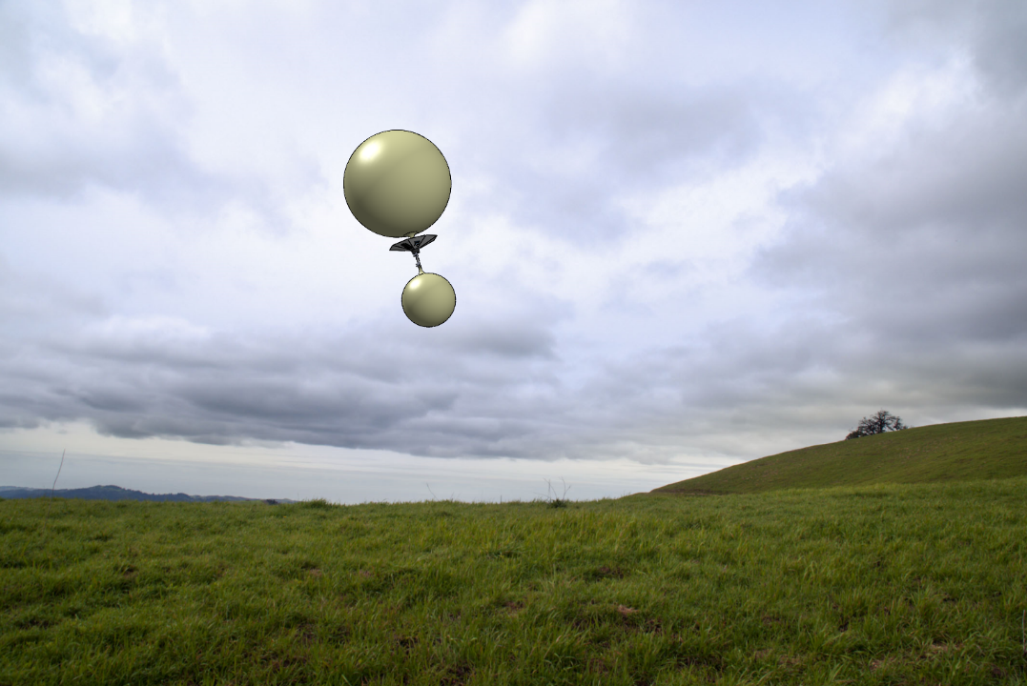

Slide 11
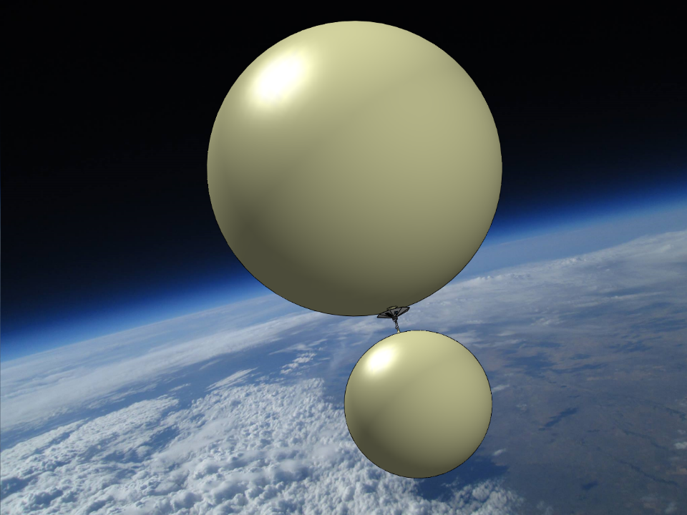

Slide 12
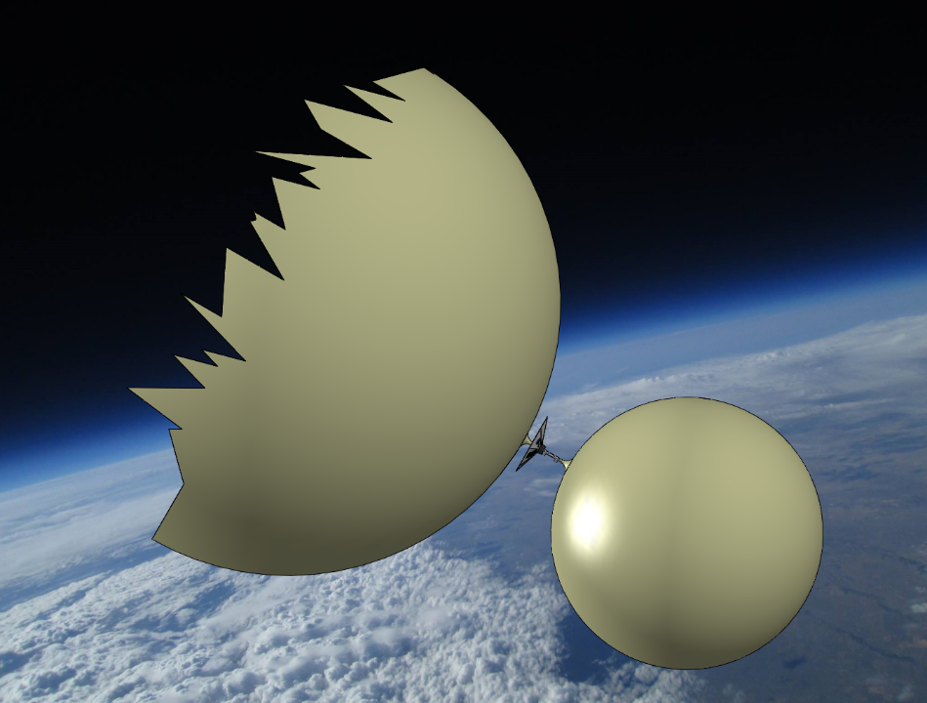

Slide 13
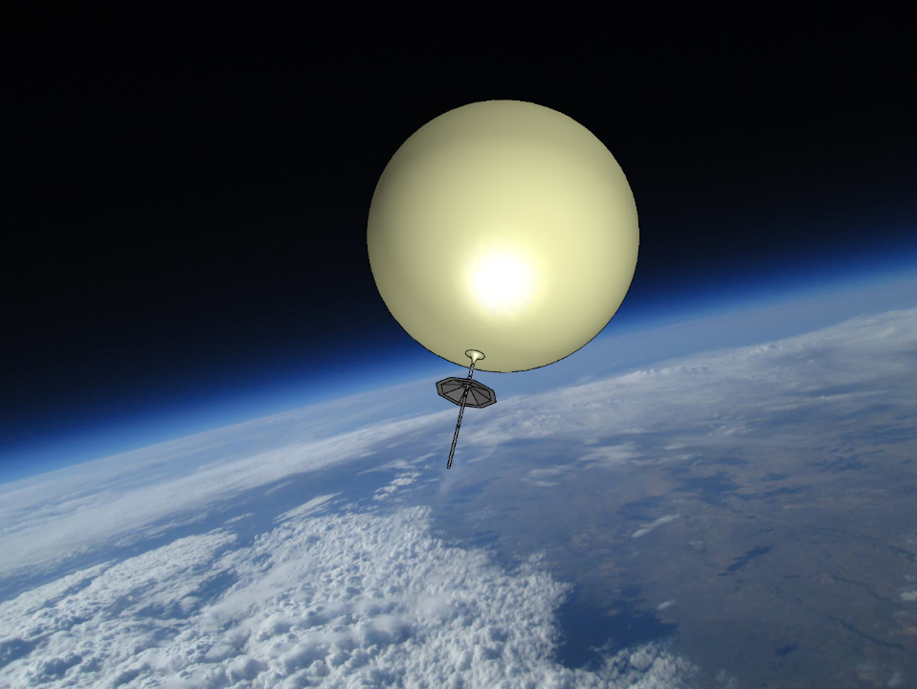

Slide 15
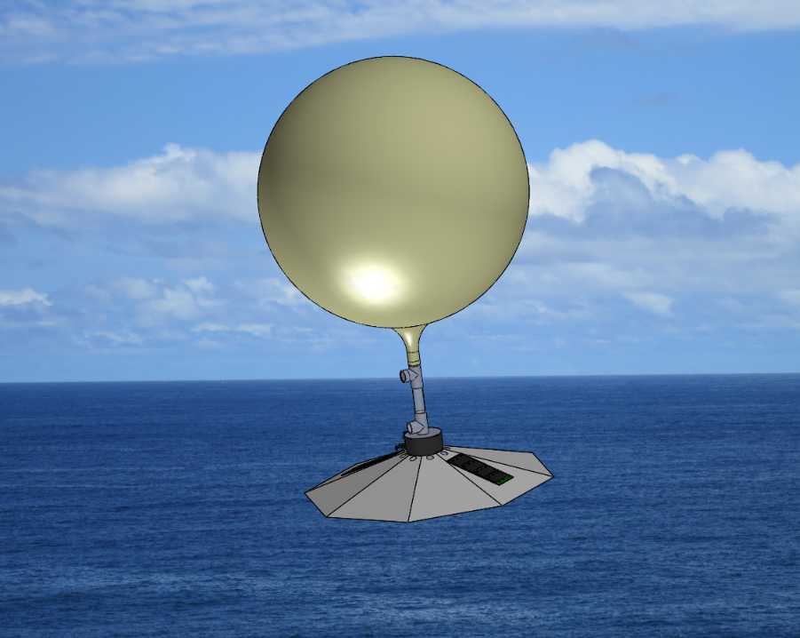

Slide 16
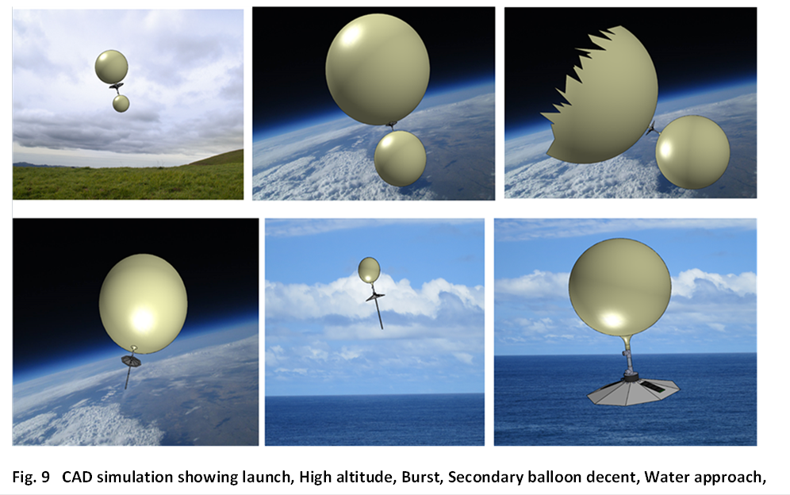

Slide 17

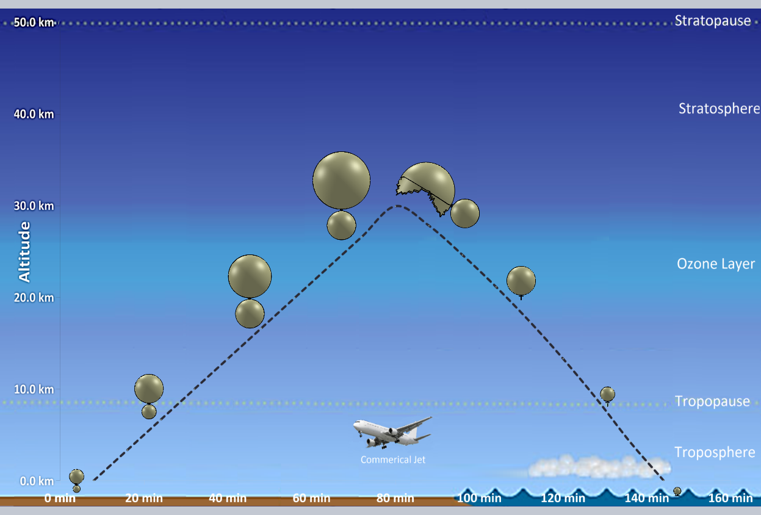
Dr. Hank Voss, Jeff Dailey, Aaron Voss, Bill Bauson, Stephen Straits

Slide 18
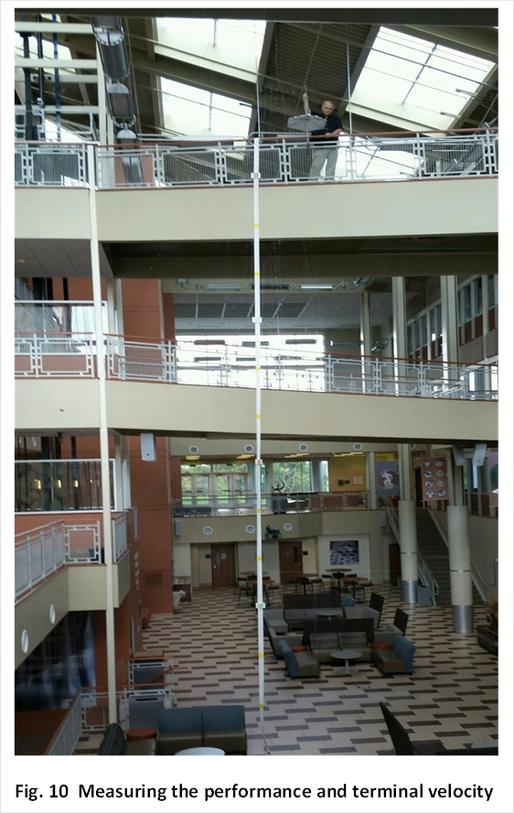

Slide 19
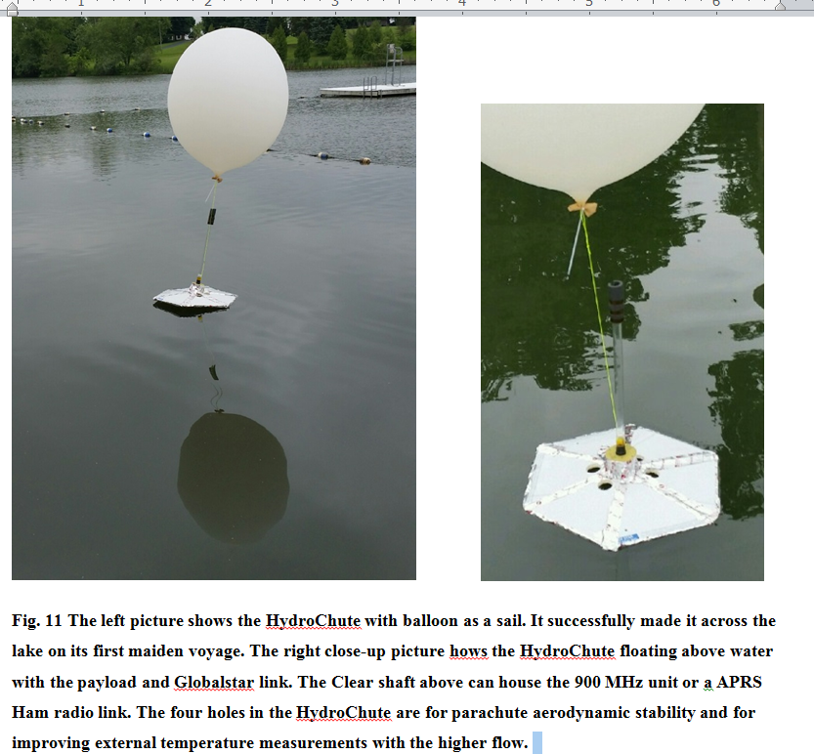

Slide 20
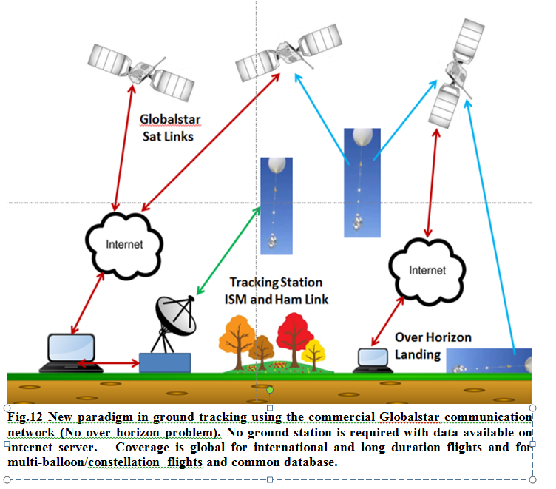

Slide 21
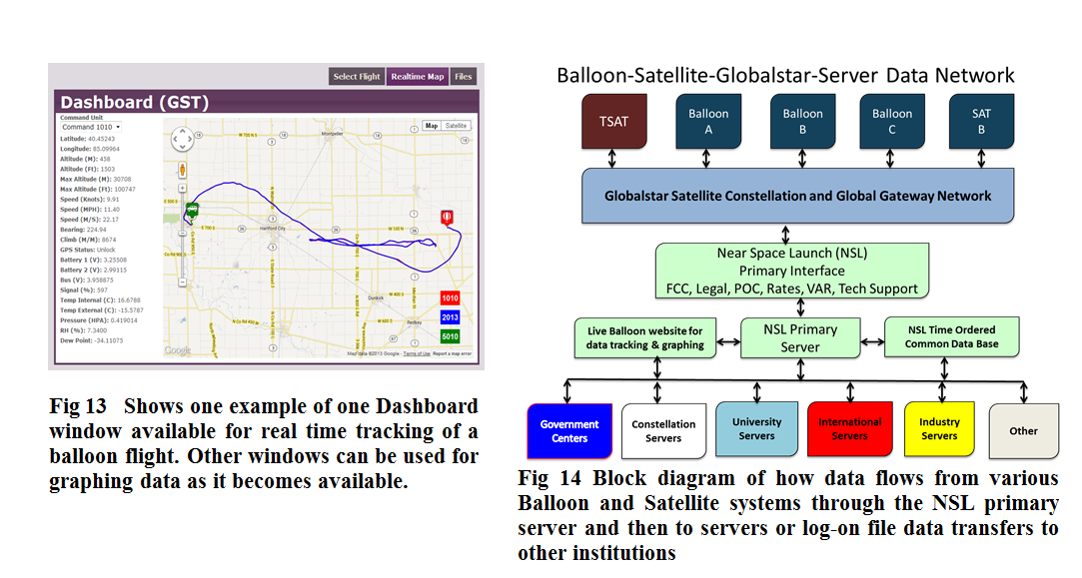

Slide 23
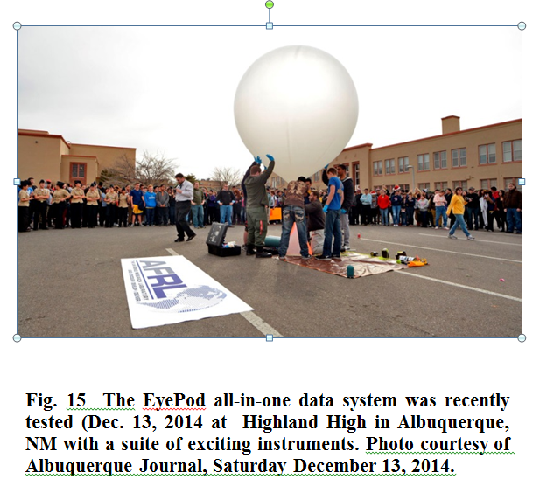

Slide 24
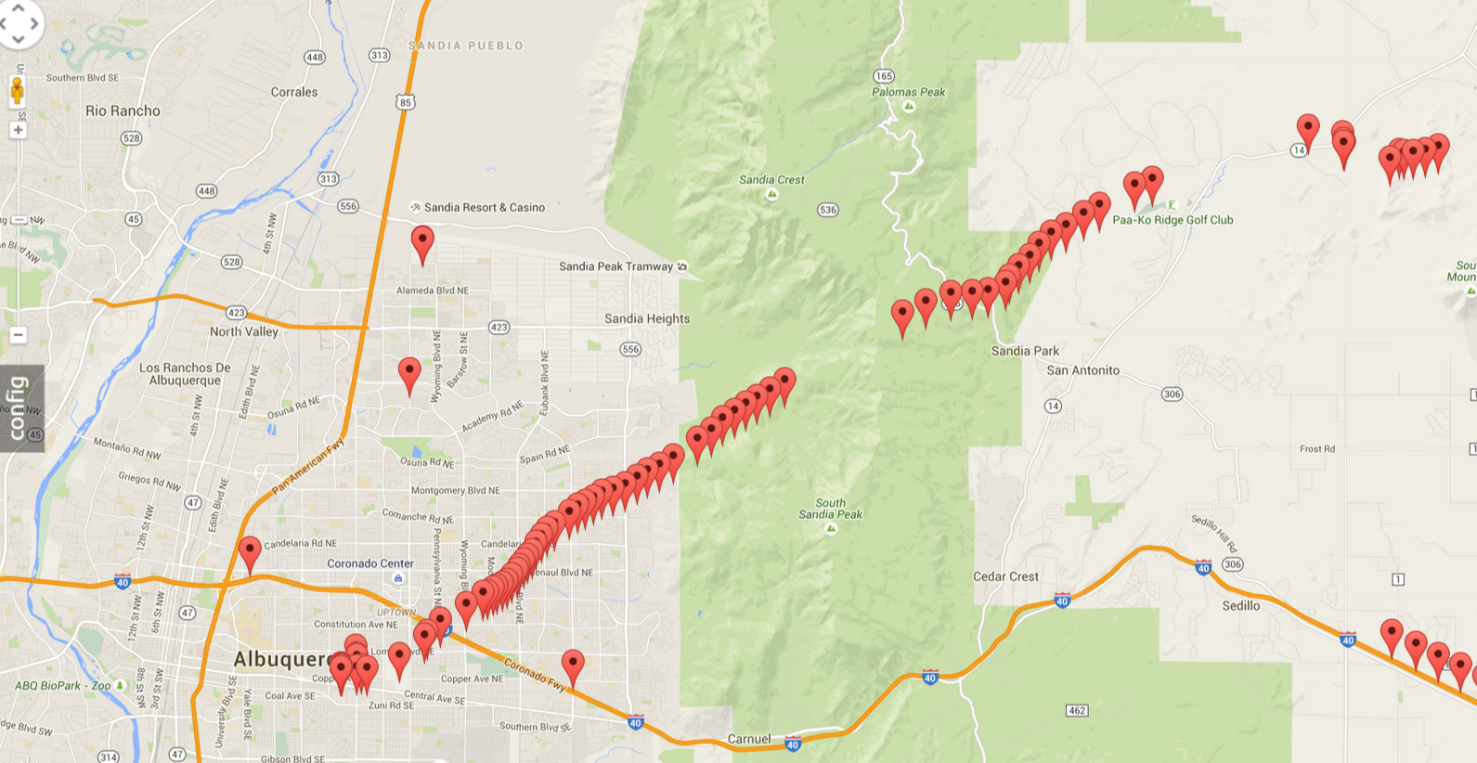
Urban Launch, Rugged Terrain

Slide 25
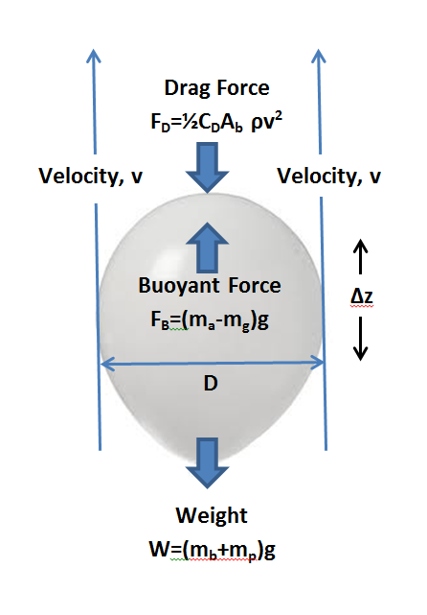
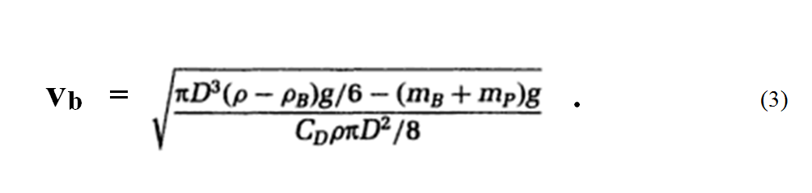
Understanding High-Altitude Balloon Flight Fundamentals, See AHAC 2012 conference, Nashville, TN, Voss et al.
Steady State
F_{L} = F_{B} – W = F_{b} - m_{G.} g = drag

Slide 26
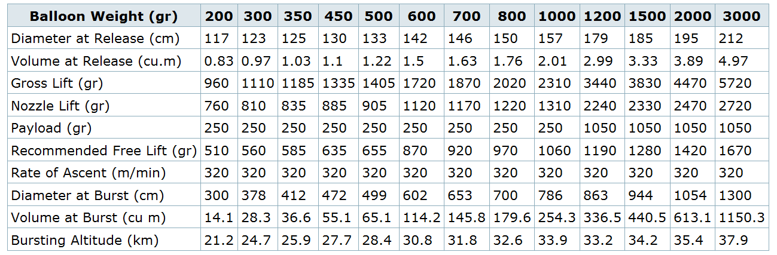
Table 2 Reference Totex Balloon Data
Gross Lift = m_{a}-m_{g} , Nozzle Lift = GL-m_{b} , Free Lift = NL-m_{p}
“Its worth noting that the data above is based on the use of Hydrogen rather than Helium. The Balloon Gross Lift is the lift generated by the volume of Gas. Hydrogen has a density of about 0.09 kg/m³ and air about 1.2 kg/m³ at normal atmospheric pressure - generating a lift of a bit over 1.1kg/m³. Helium has a density of about 0.17Kg/m³ - generating a lift of a bit over 1.0 kg/m³. Subtract the Balloon Weight plus the Payload weight from the Gross Lift to give the free lift.” (http://ukhas.org.uk/guides:balloon_data)

Slide 28


Slide 29
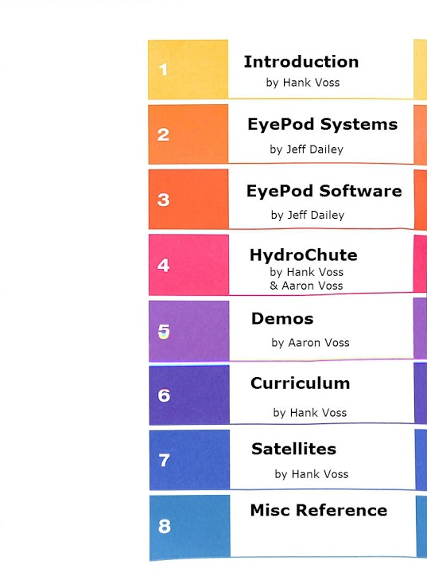

Slide 30
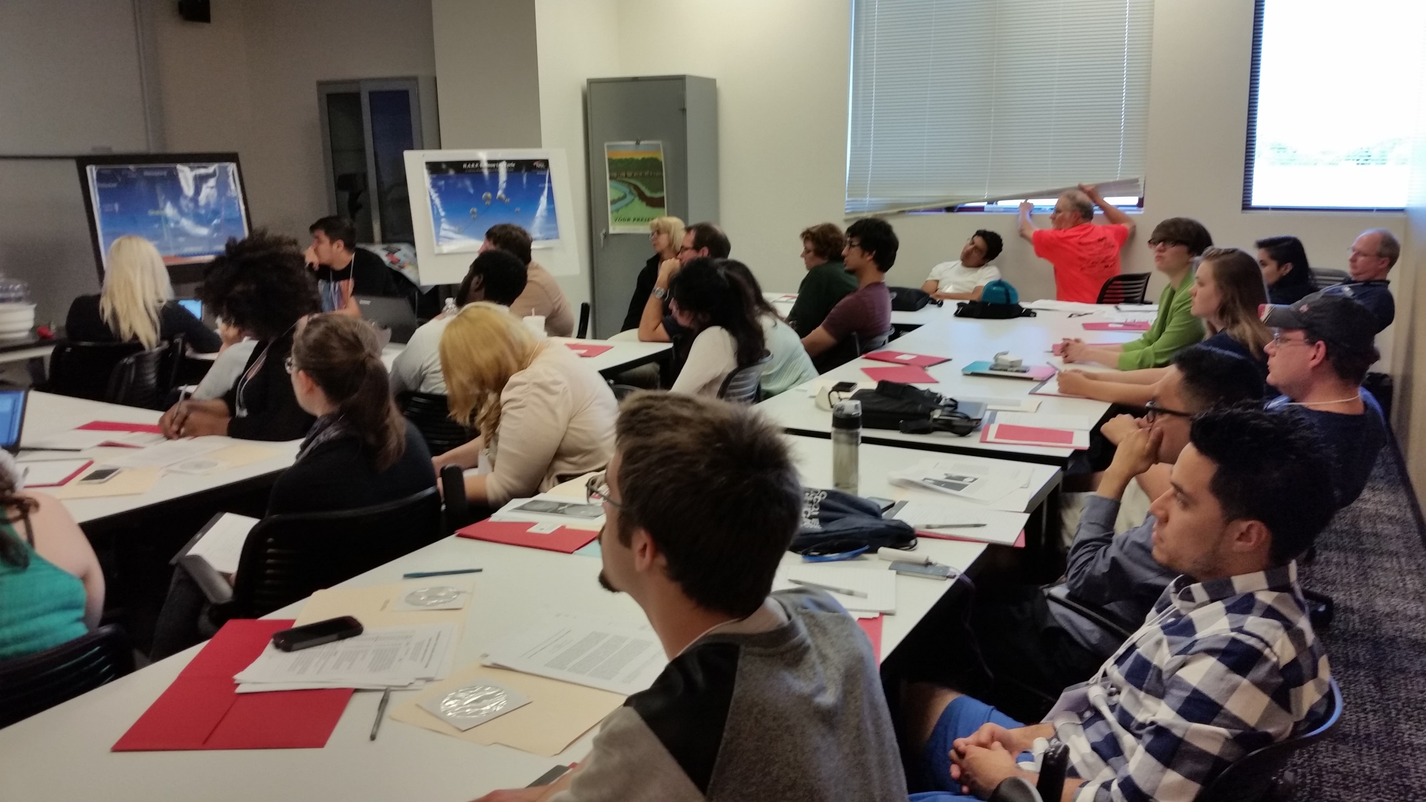
Workshop with 33 Participants

Slide 31
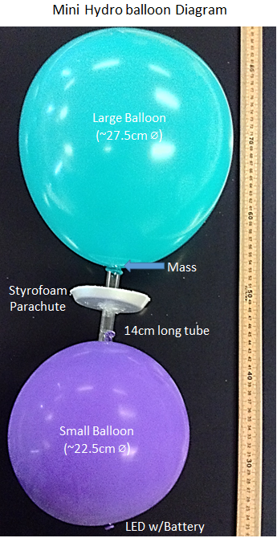
Mini Hydro balloon basic steps
Get all of your parts and list them out
Cut out the Styrofoam HydroChute
Record the mass of each of the parts
Calculate the Balloon size and volume for getting a Nozzle lift of 10-11g
Install a few gram mass in tube top for battery mass and small anchor
Fill He in Large balloon and seal, tie wrap
Add HydroChute to tube (glue or epoxy)
Fill He in Small balloon so it has small Free lift
Seal small balloon to tube and tie wrap
Photograph assembly
Ready for testing
Measure rate of ascent to ceiling (3 times)
Remove or pop large balloon and record descent speed
Photo Assembly with LED in water bucket
Document your results and adjustments
Large Balloon
(~27.5cm ⌀)
Mass
Styrofoam
Parachute
14cm long tube
Small Balloon
(~22.5cm ⌀)
LED w/Battery

Slide 32
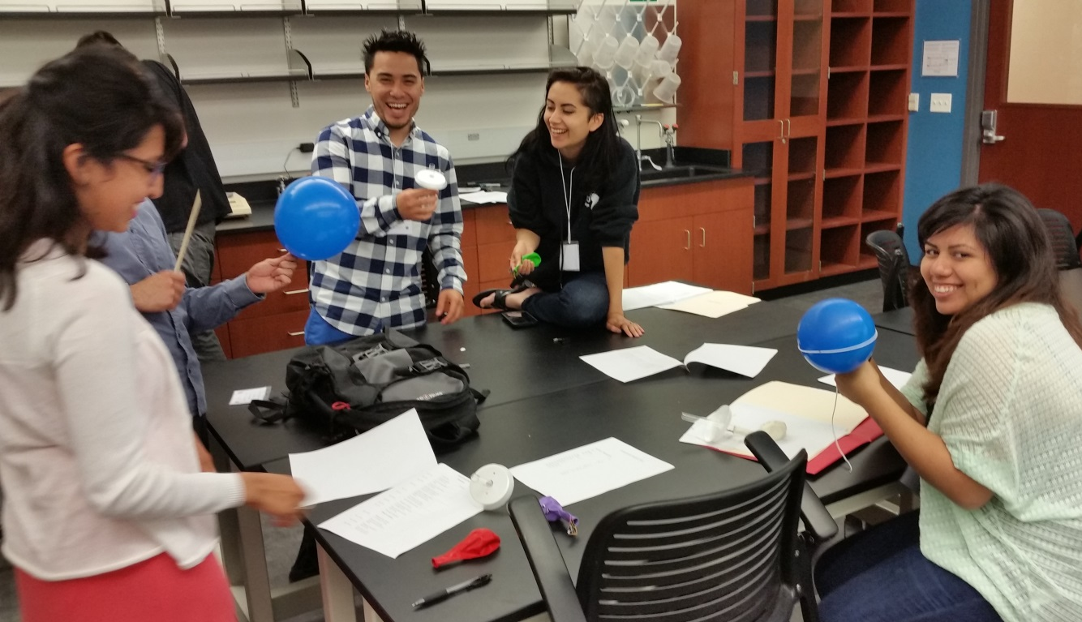
Workshop Breakouts

Slide 33
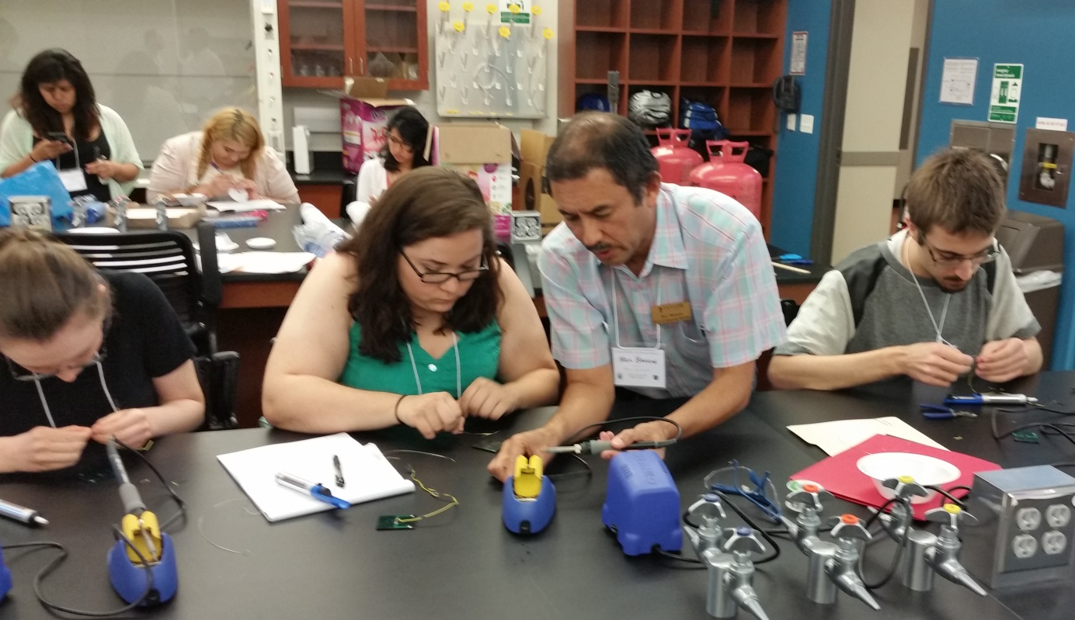
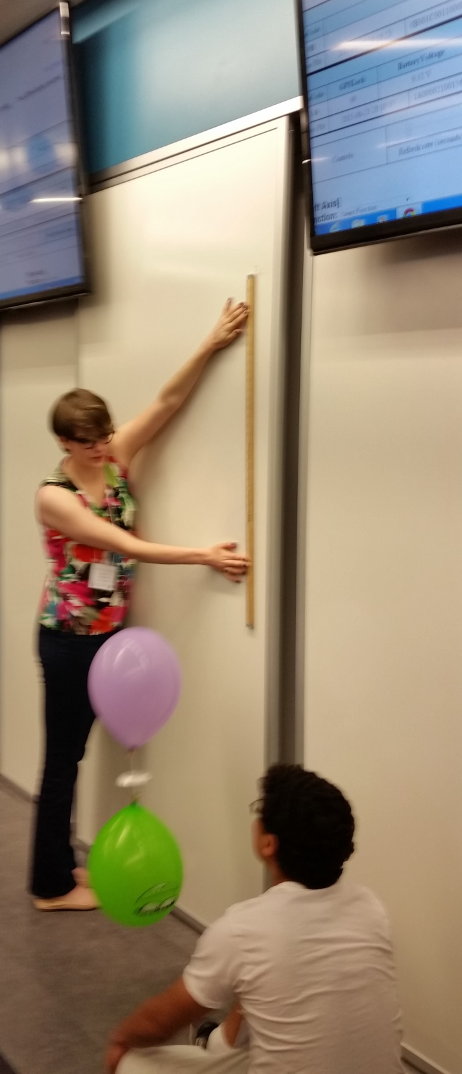
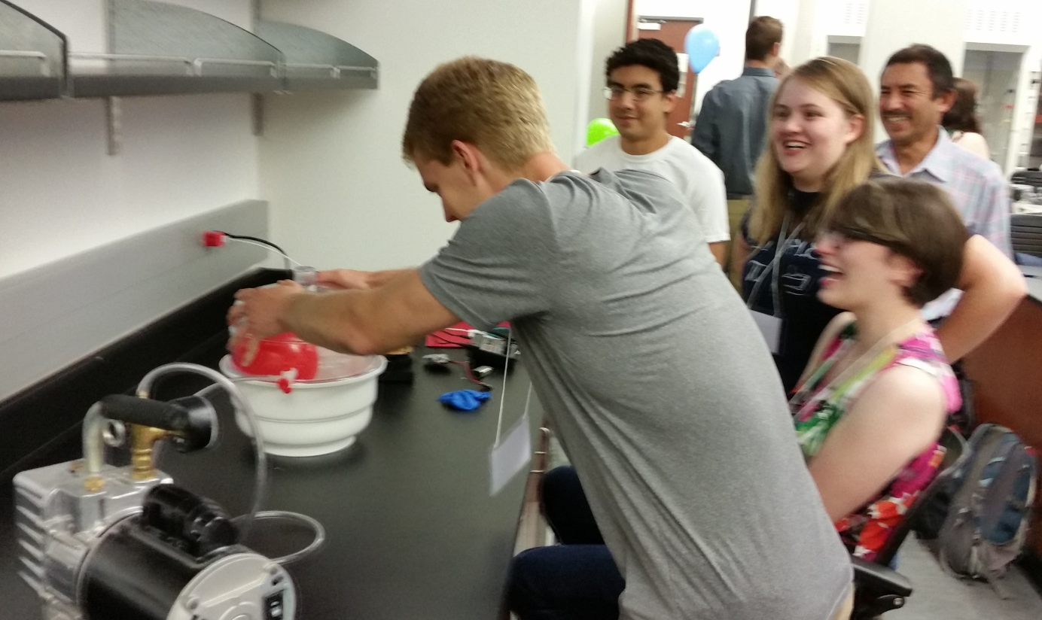

Slide 34
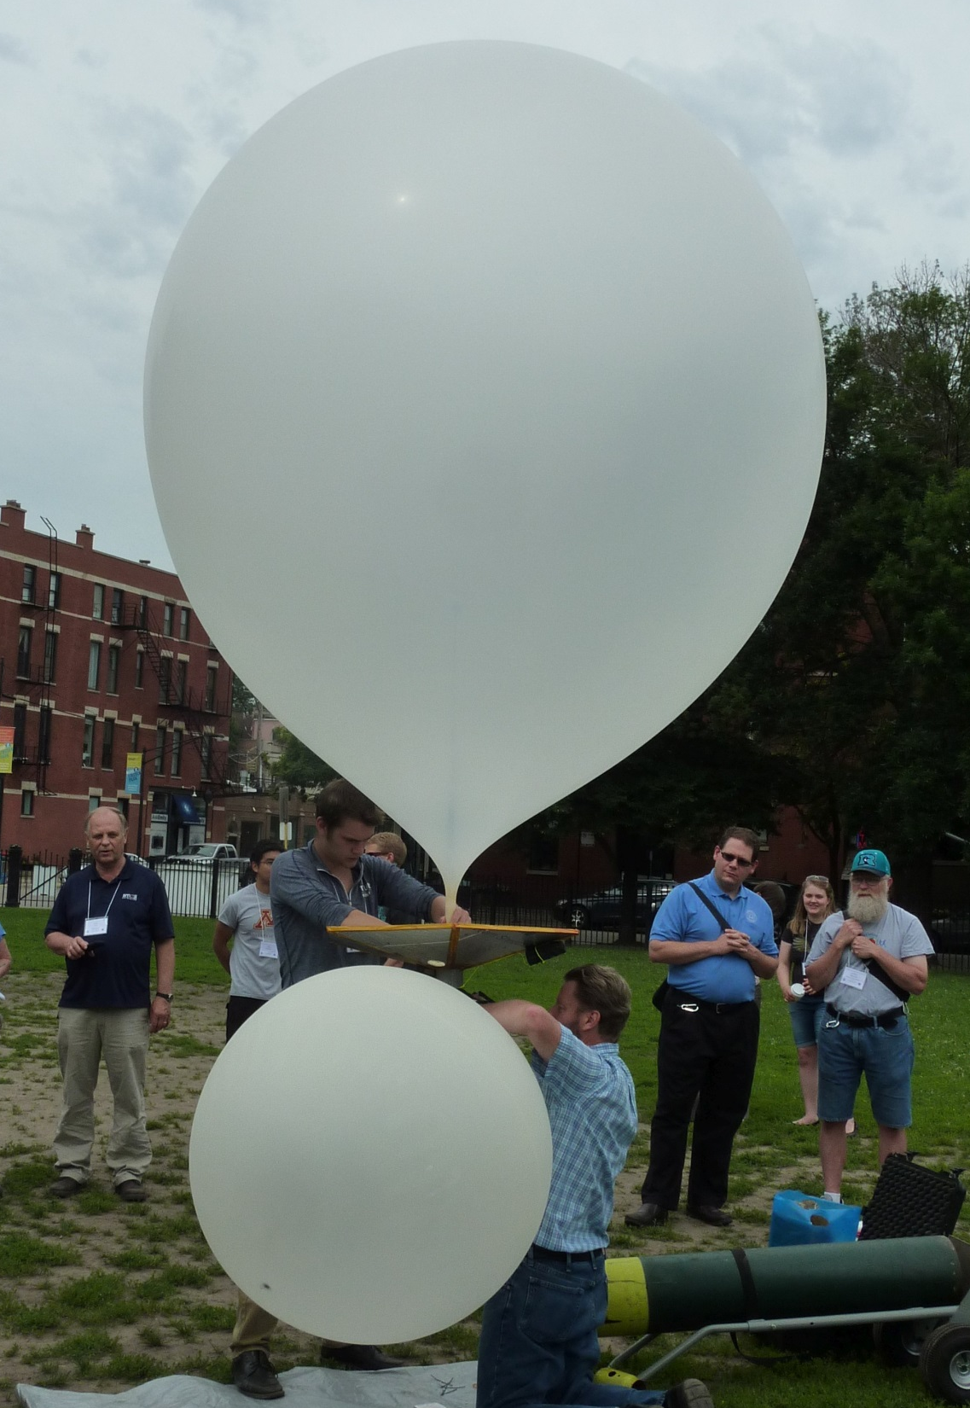

Slide 35
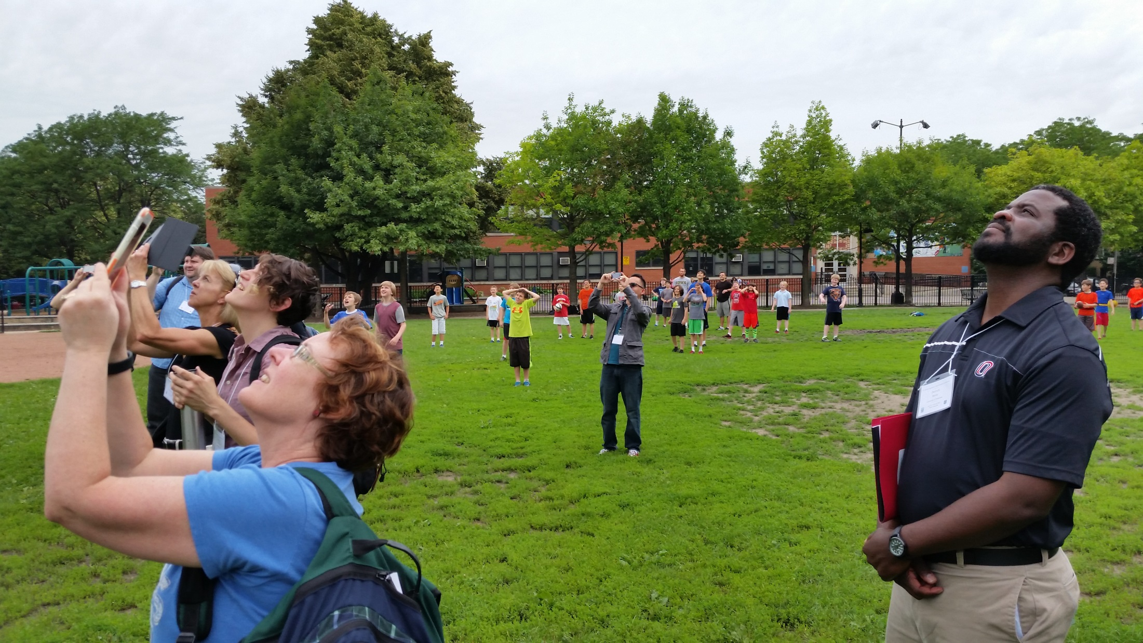


Slide 36
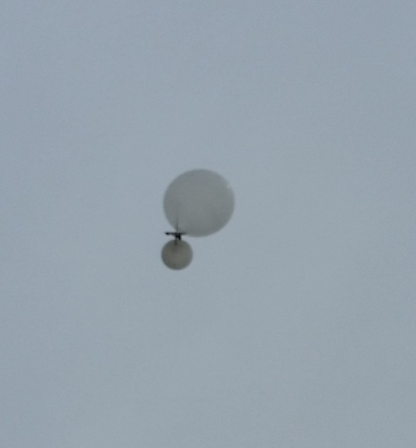
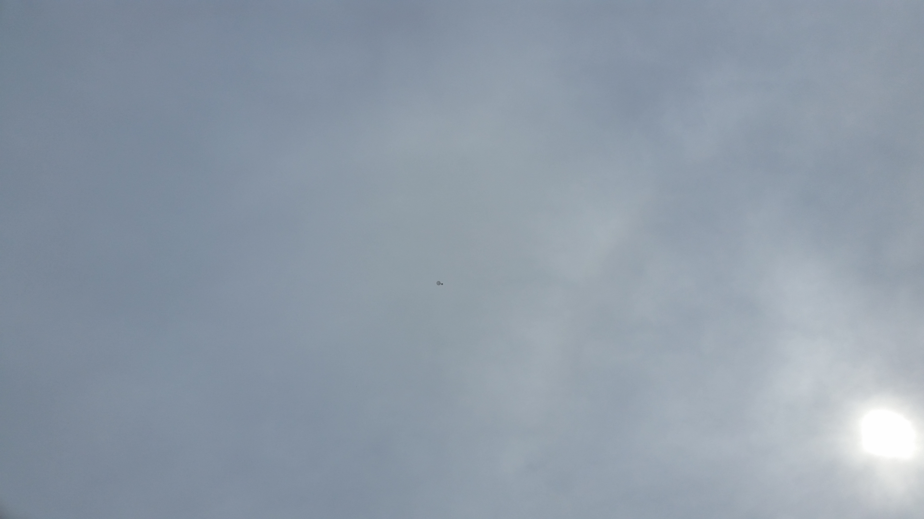
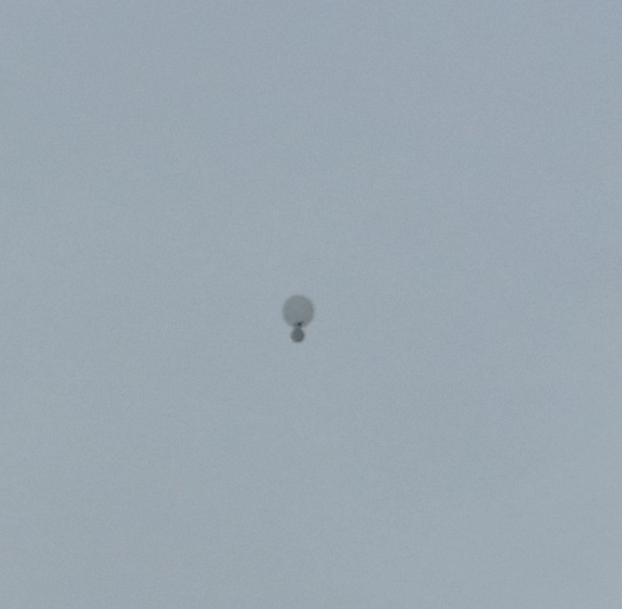
Dynamics
Video

Slide 37
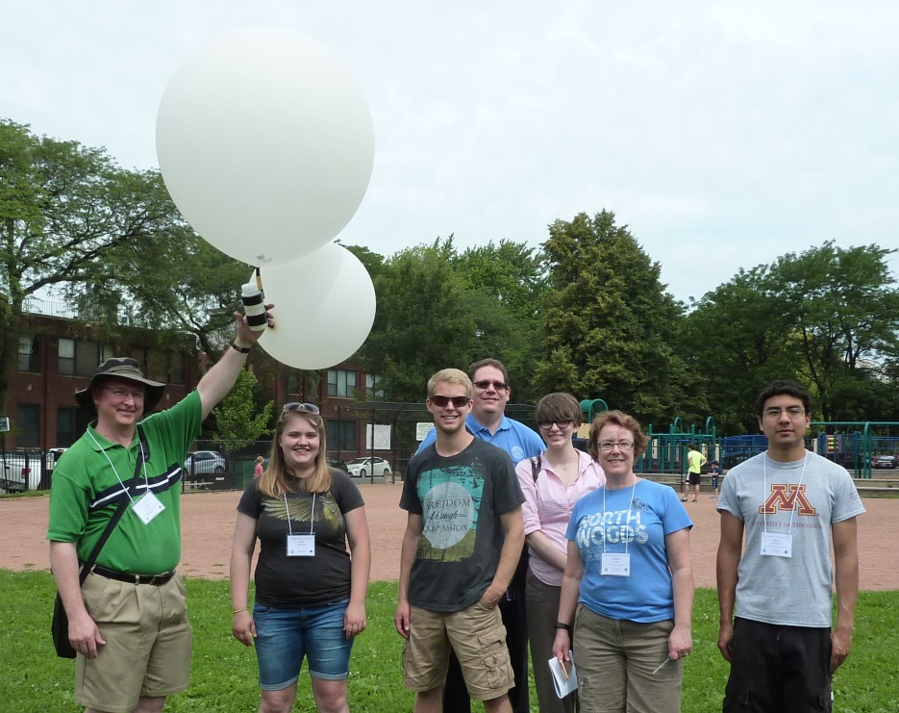
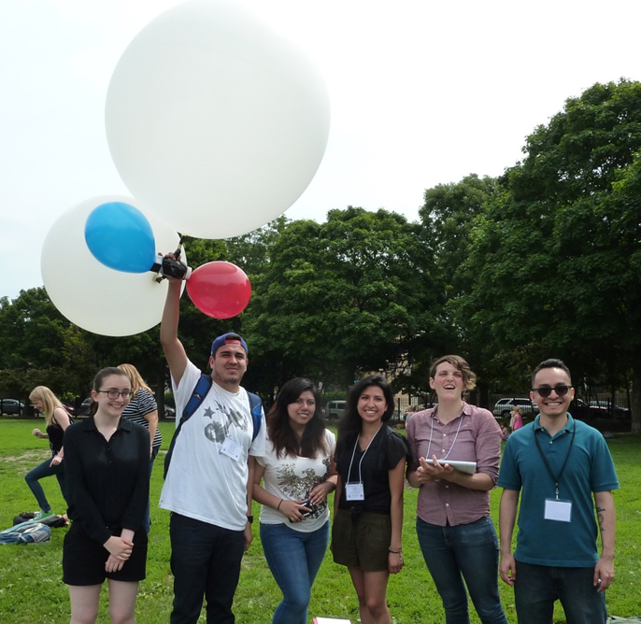
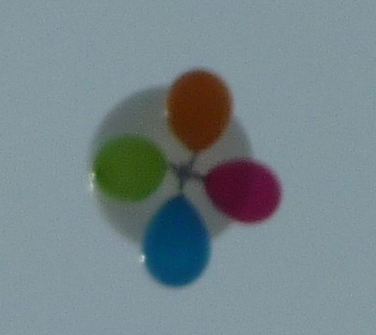
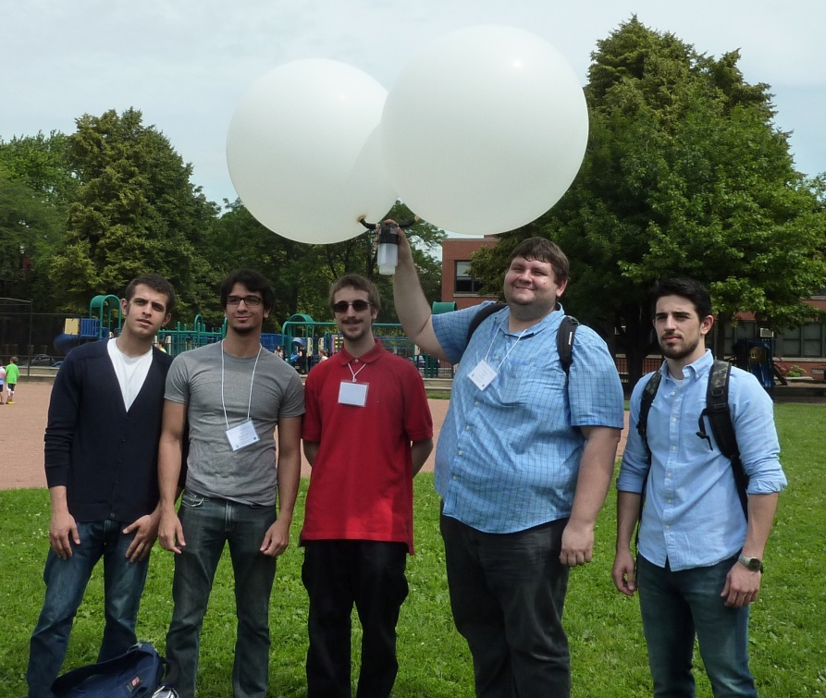
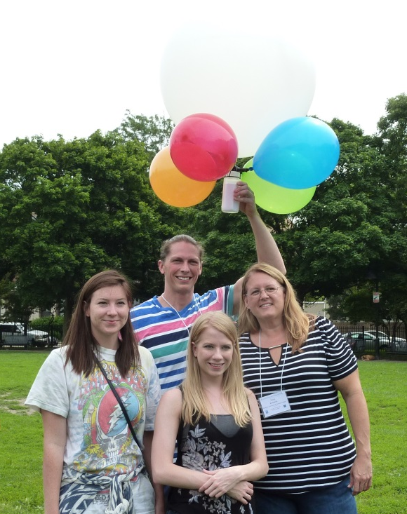

Slide 38
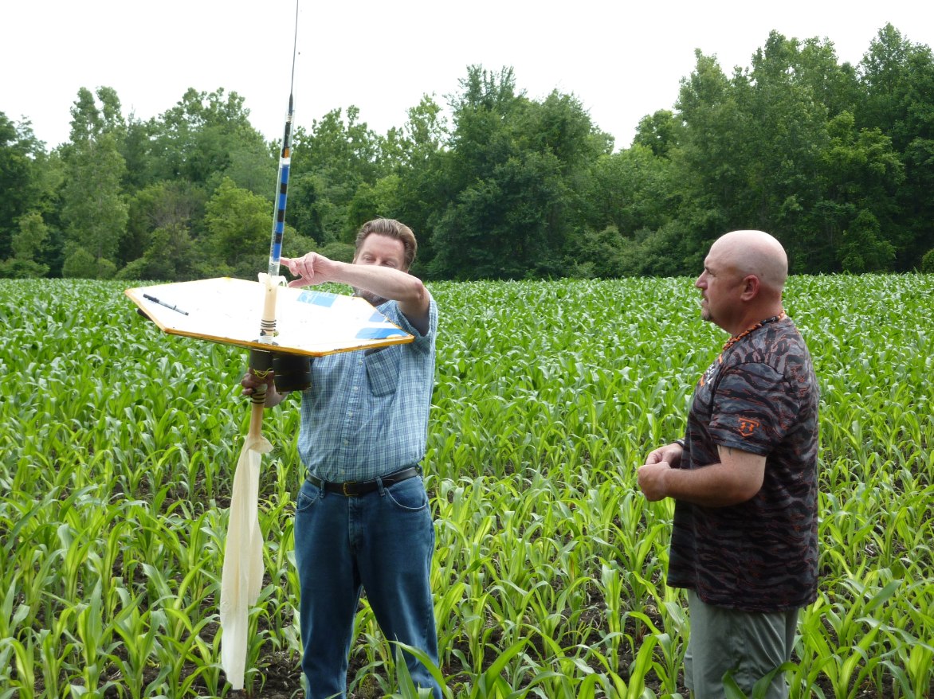

Slide 39
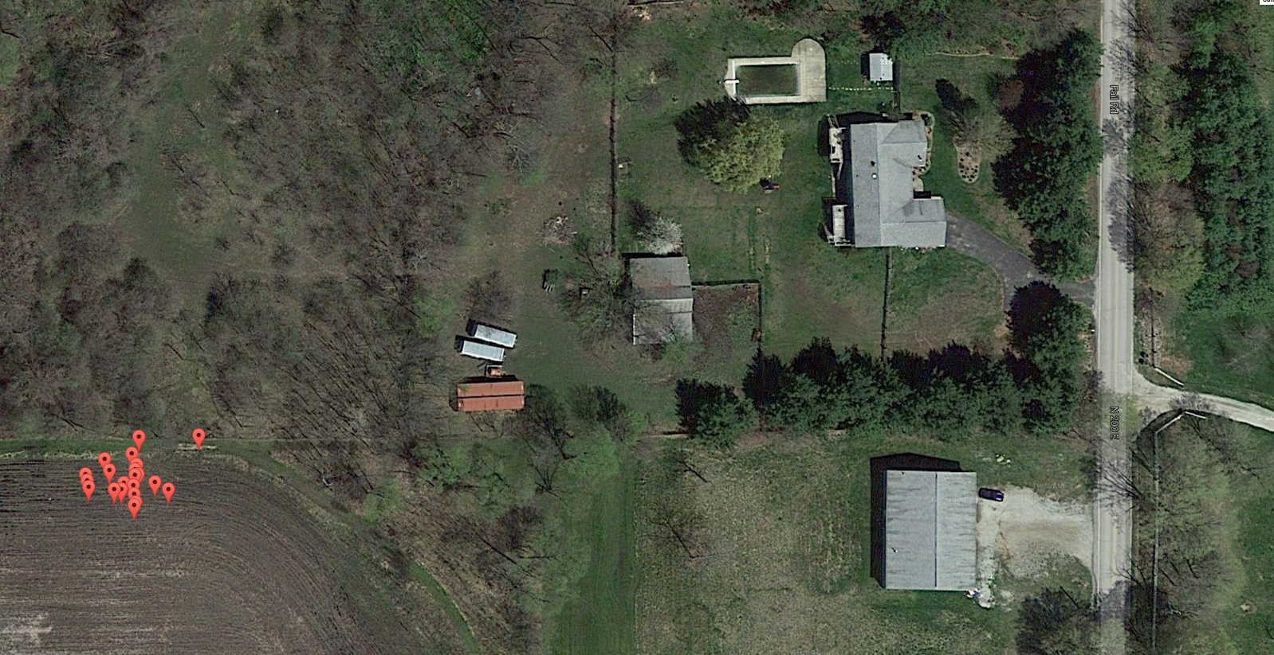
Hydro-Foil Blocked GPS and G* on Ascent
EyePod GlobalStar data at landing site

Slide 40
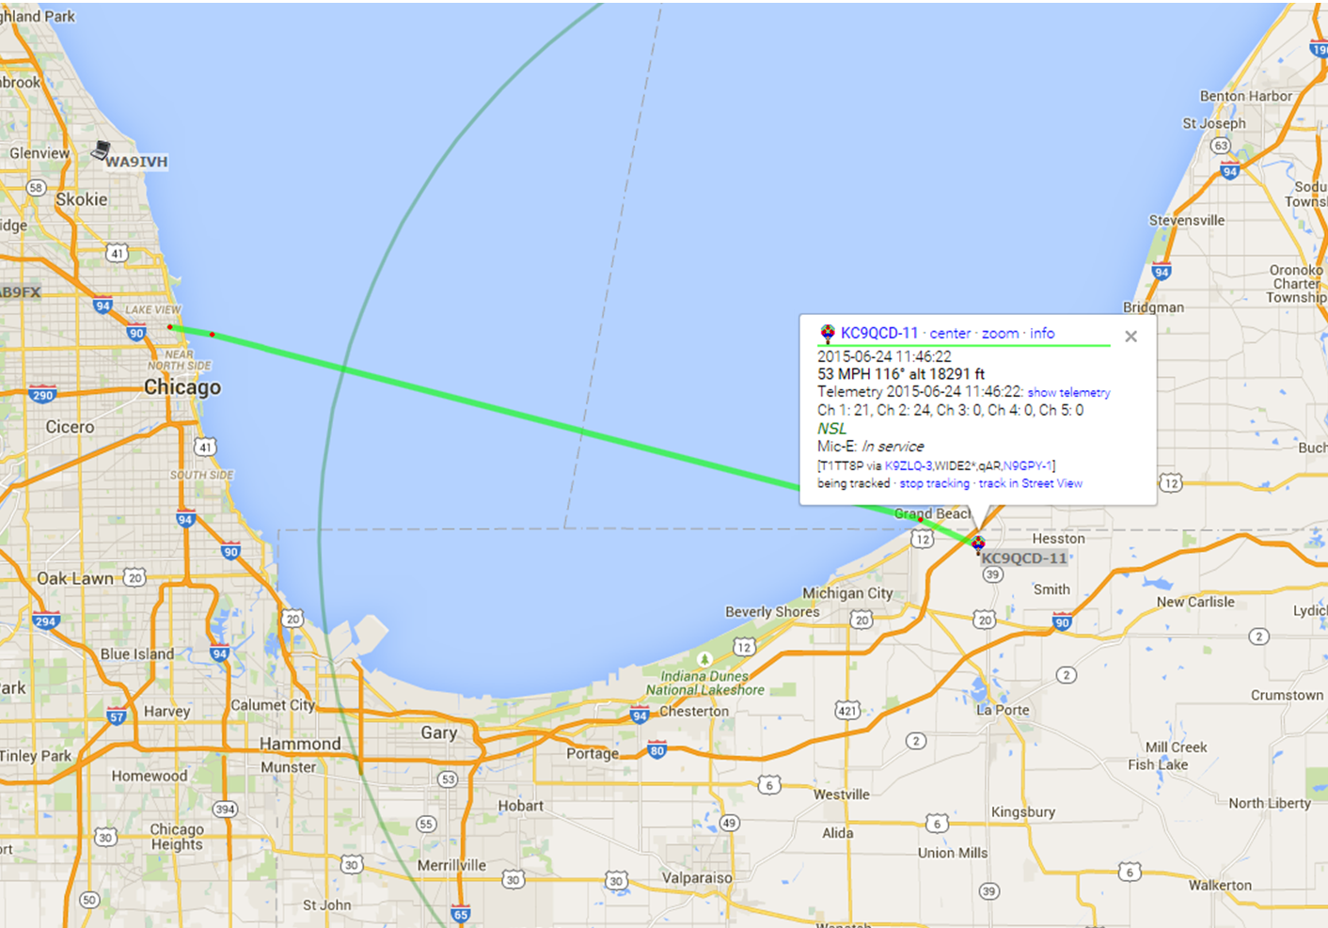
APRS Ham Radio

Slide 41
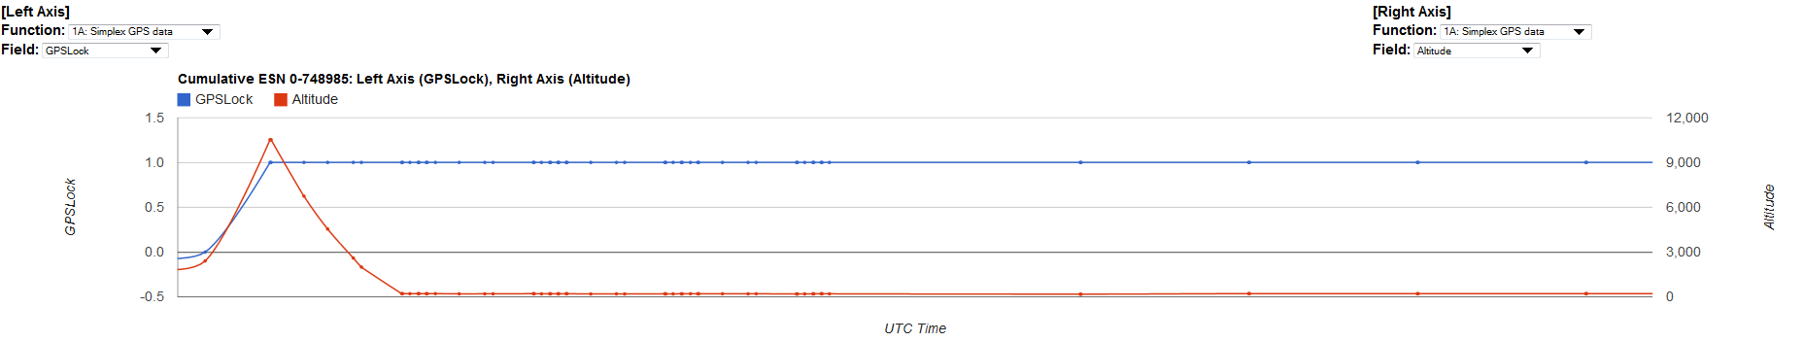

Slide 42
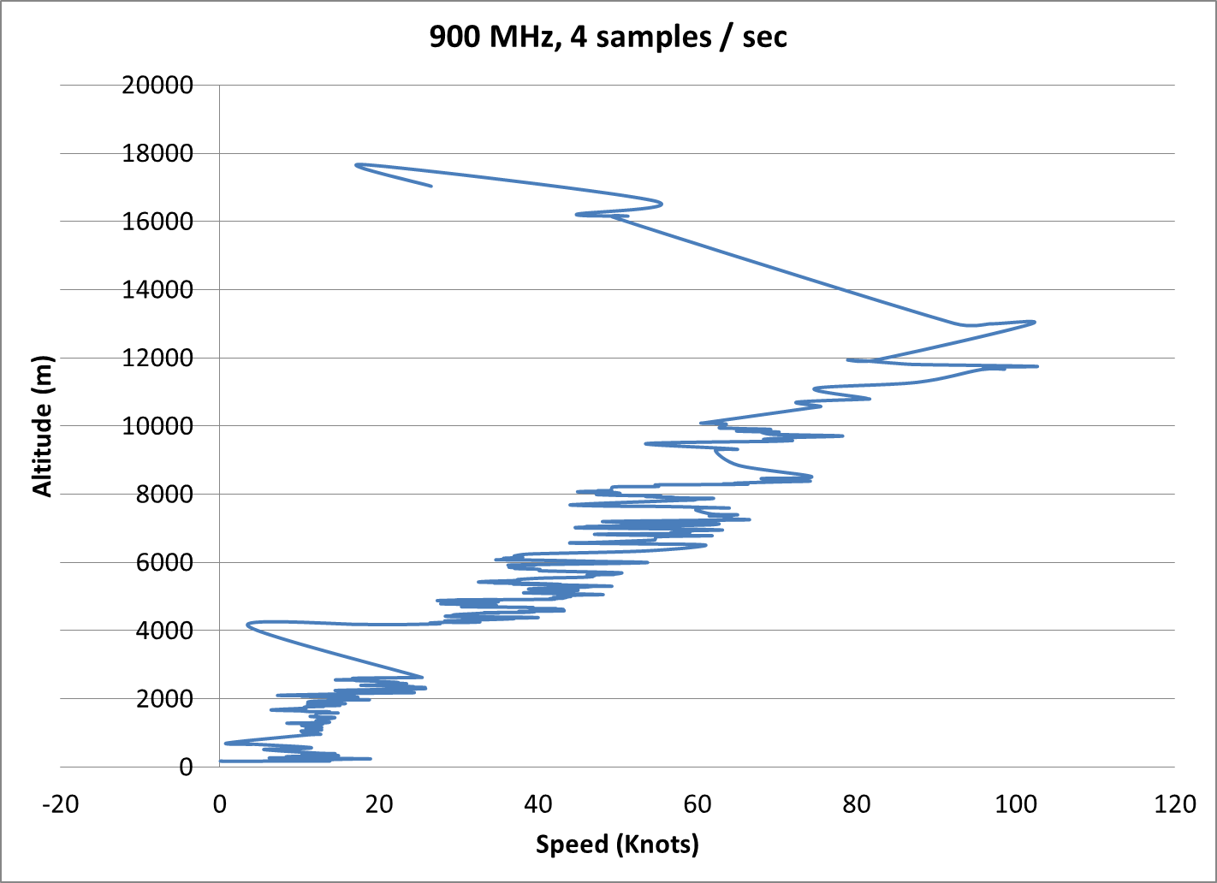

Slide 43
EyePod-3 GlobalStar All-In-One System with 900 MHz :ink
Contact Hank Voss (hankvoss@nearspacelaunch.com) or Jeff dailey (jfdailey@nearspacelaunch.com)

Slide 44
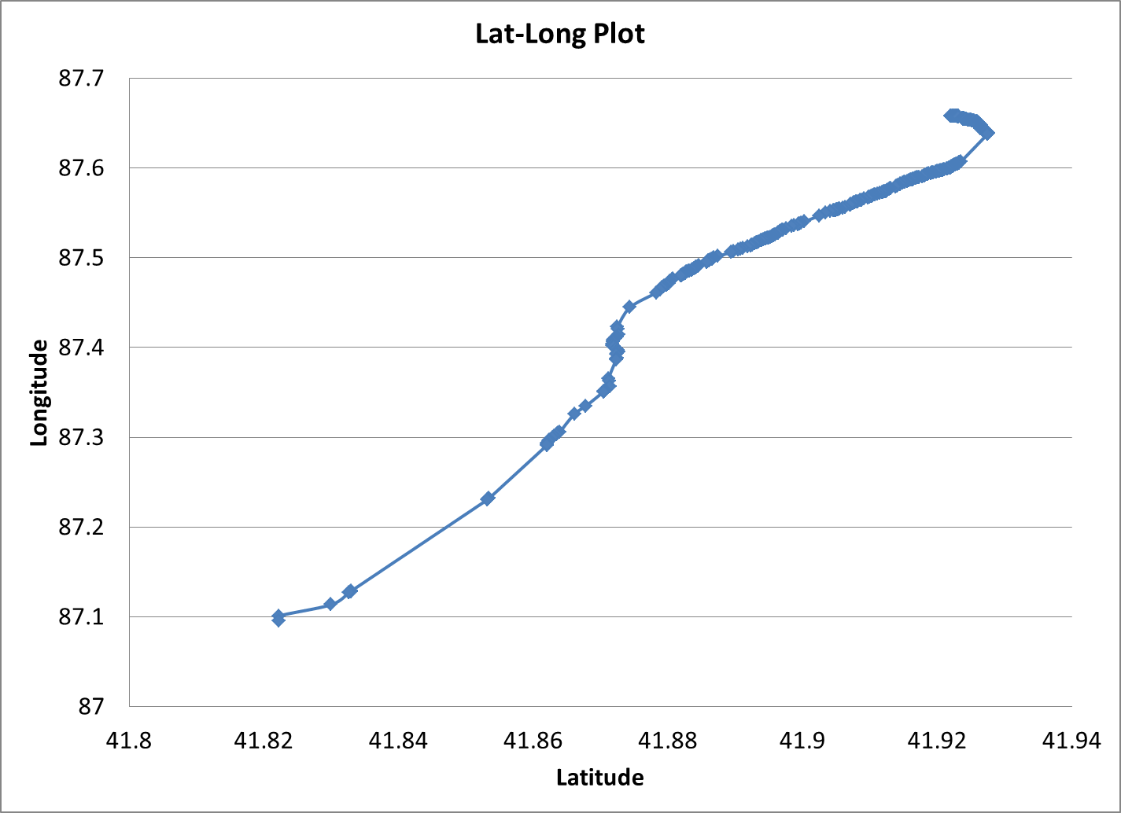
APRS Ham Radio

Slide 45
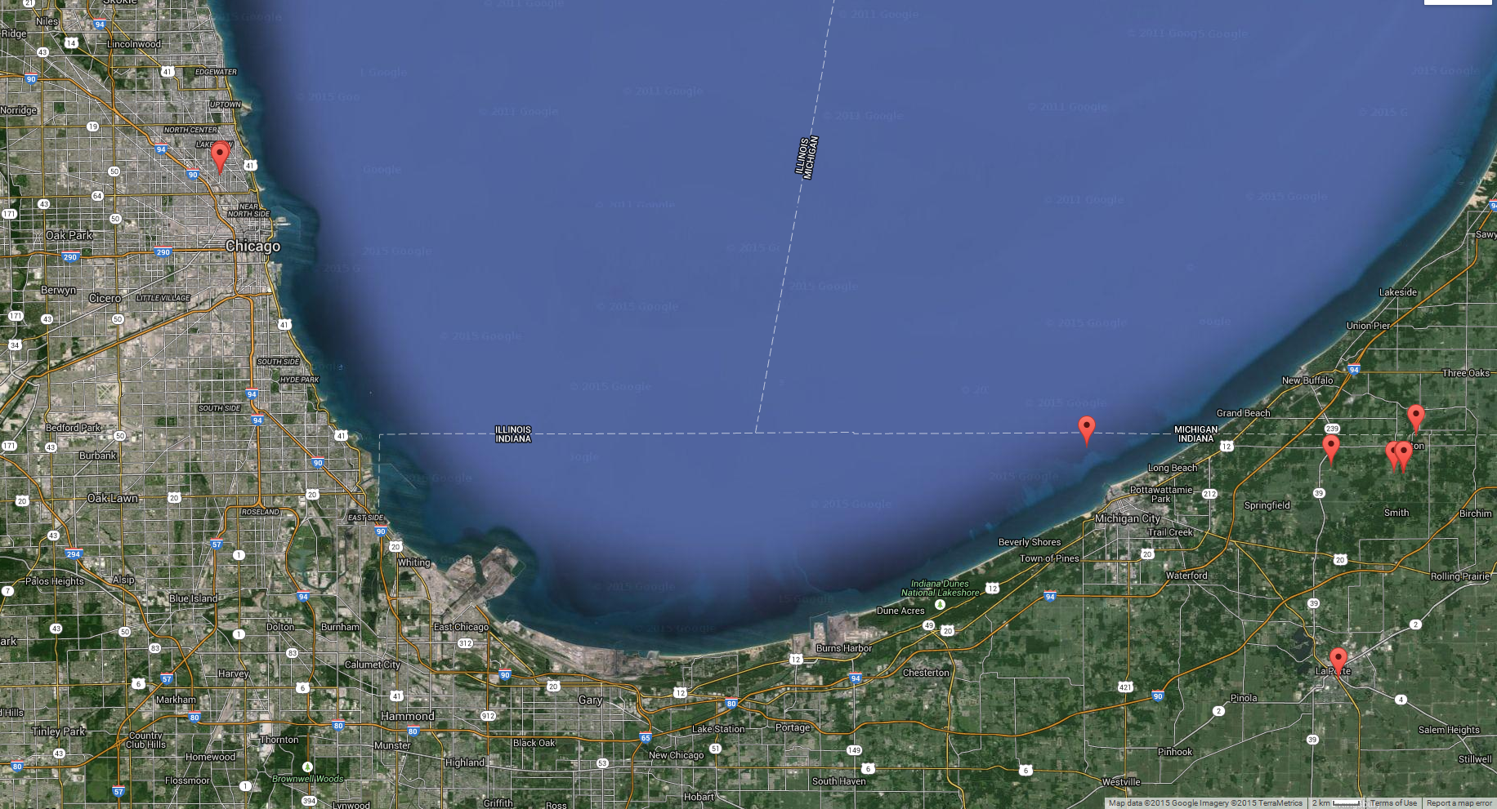
Loss of signal due to Hydro chute above Eyepod antenna
Hydro chute below Eyepod antenna

