Slide 1
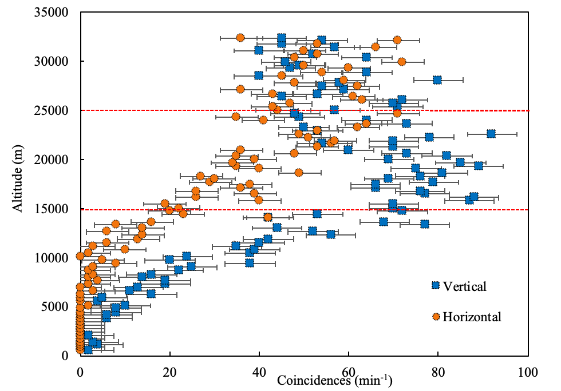
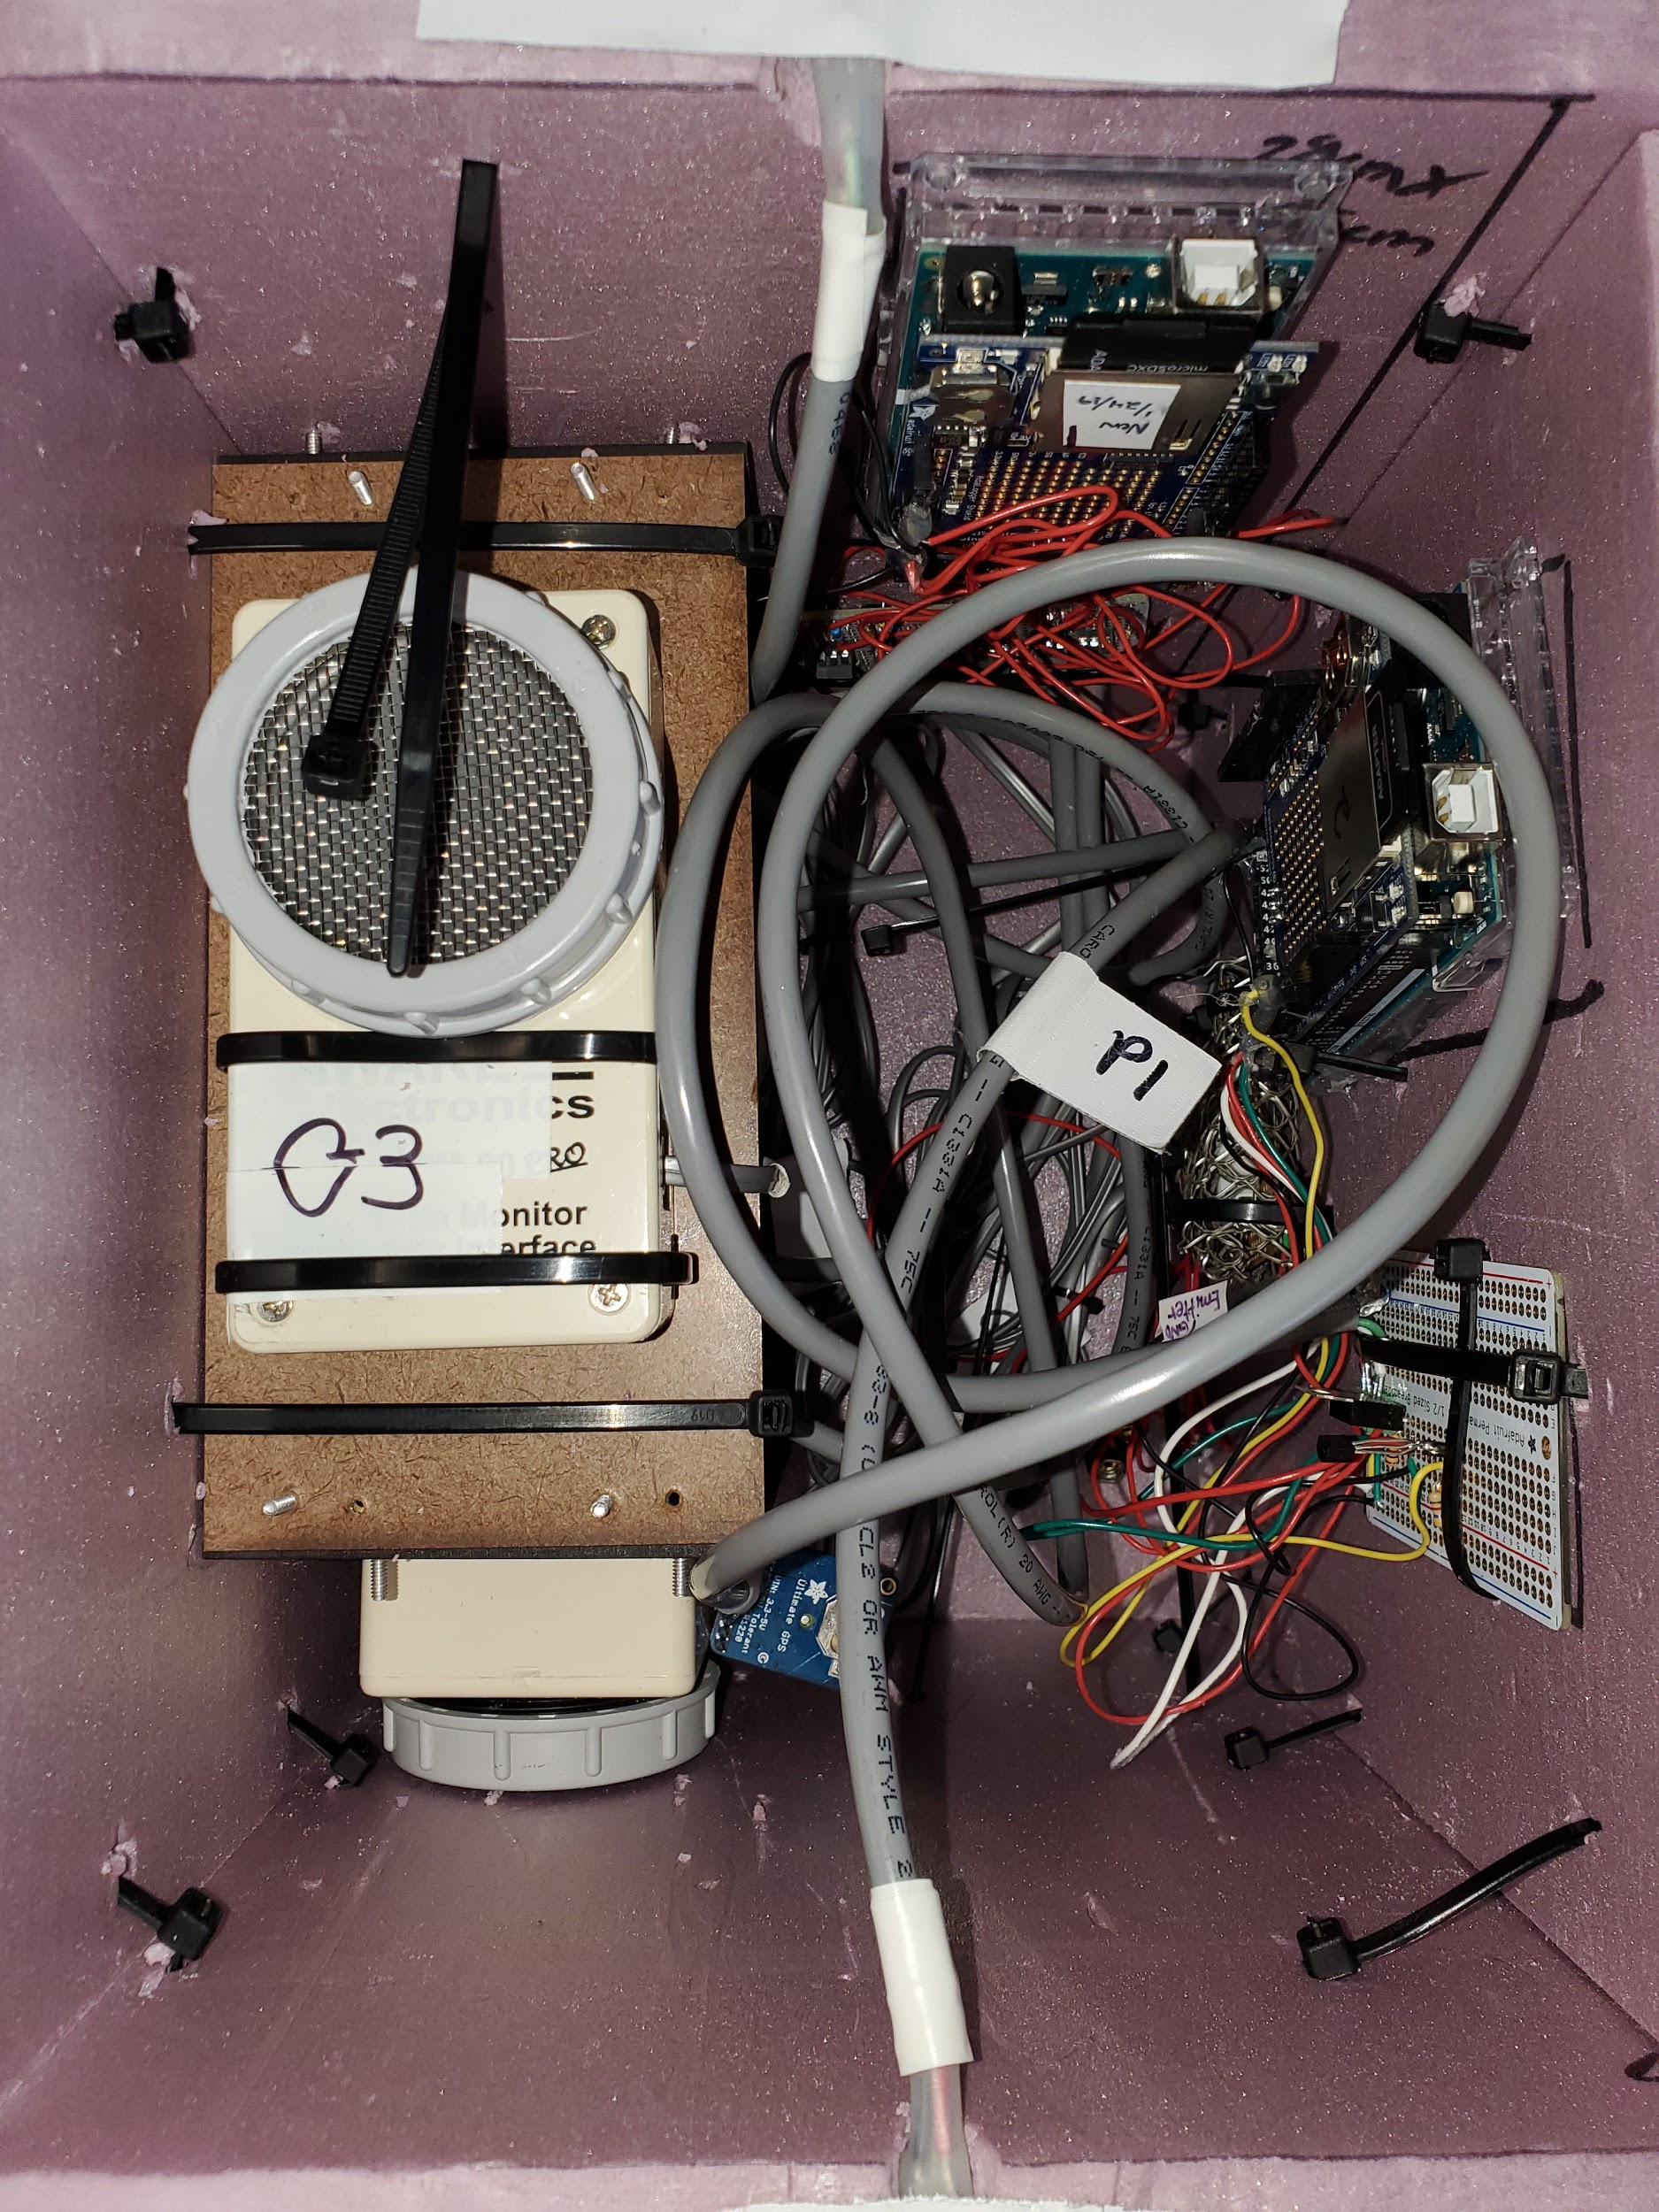
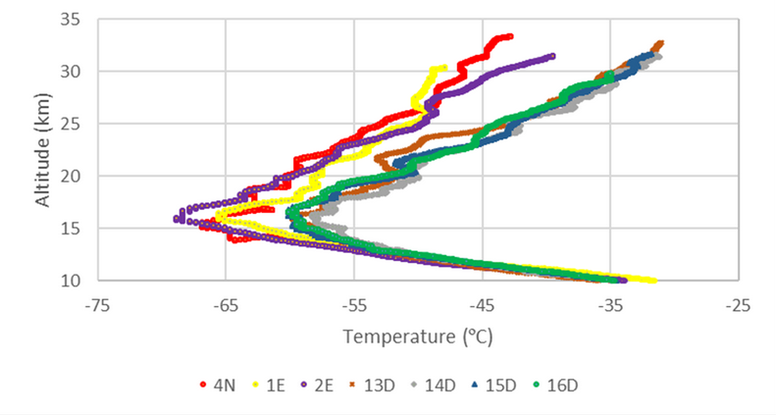
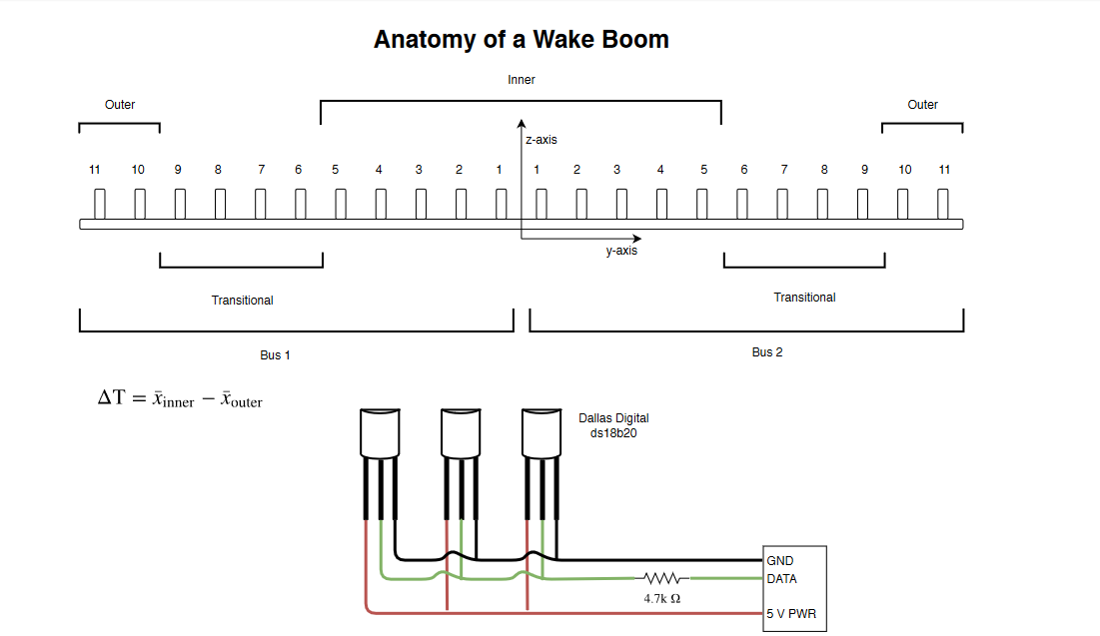
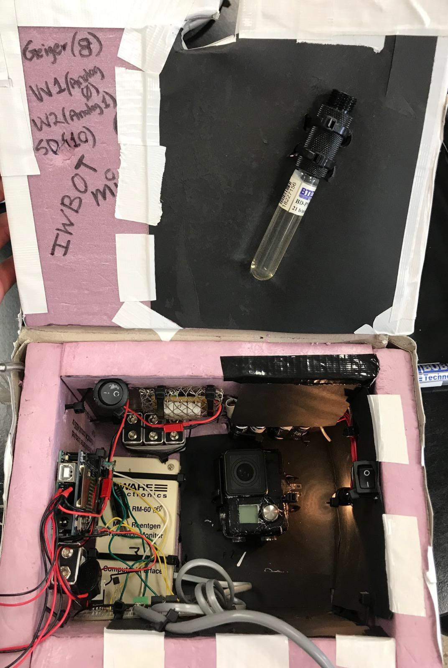
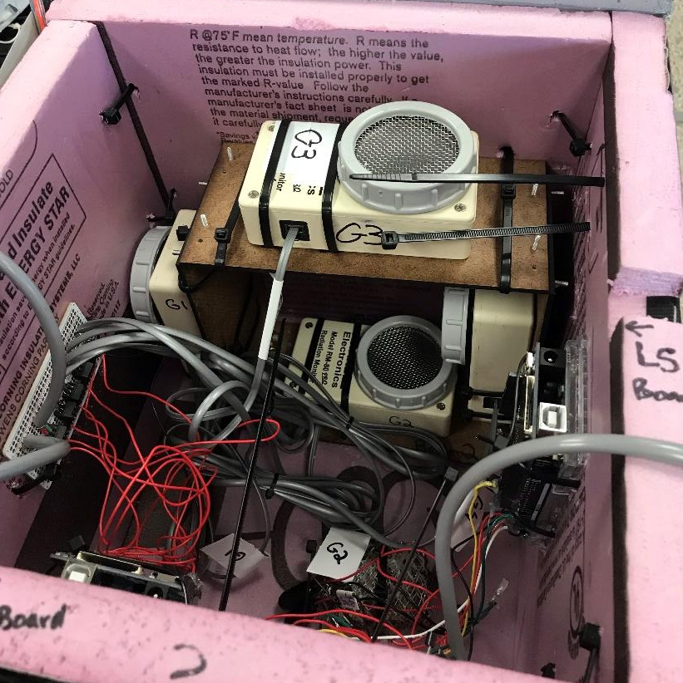
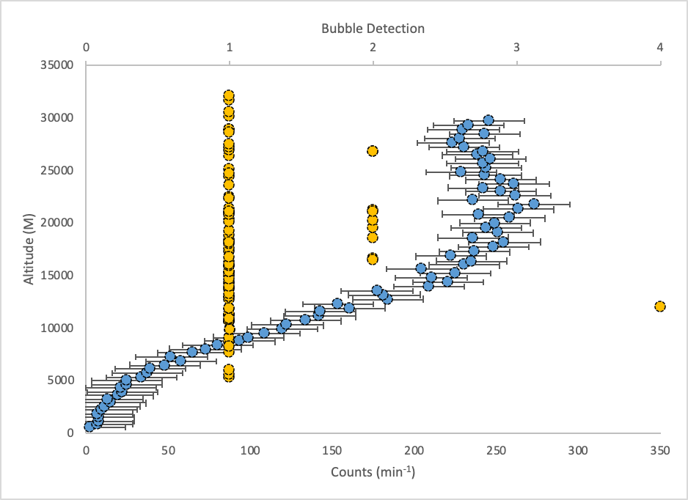
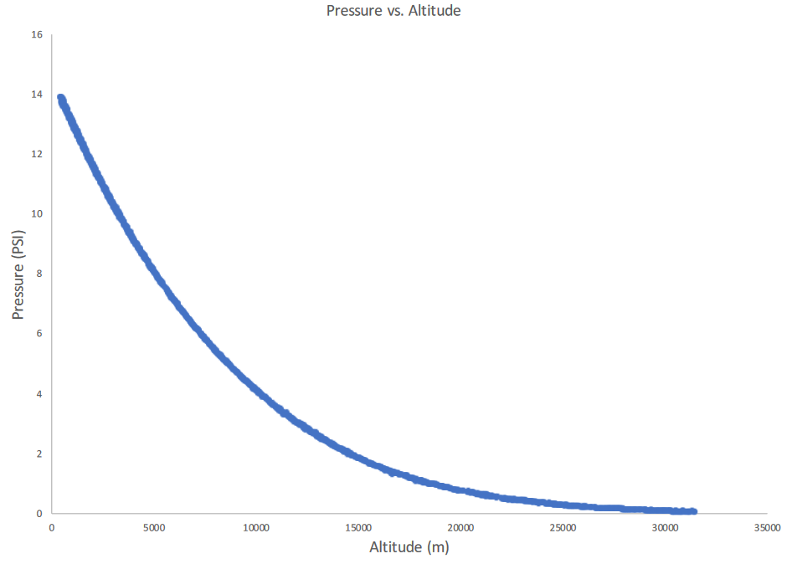
Measurements Recorded via Stratospheric Ballooning
Anisa Tapper, Callie Korzeniowski, Gillian Durand, Judy Panmany, Alynie Walter, Alisha Wiedmeier, Melissa Graham, Claire Weinzierl, Alynie Xiong, Brittany Craig, Rachel DuBose, Vina Onyango-Robshaw, Grace Maki,
Ana Taylor, Rachel Lang, Peace Sinyigaya, Viviana Montenegro – Cortez, Ngozi Ezenagu, Kaye Smith, Erick Agrimson, Hannah Rogers
Department of Physics, St. Catherine University, St. Paul, MN 55105
Gordon McIntosh
Division of Science and Mathematics, University of Minnesota, Morris, MN, 56267
James Flaten
Department of Aerospace Engineering and Mechanics, University of Minnesota, Minneapolis, MN 55455
Abstract
Charged Cosmic Rays
Temperature
Flight Predictions
Hydrogen or Helium filled High Altitude Balloons (HABs) carrying scientific instrumentation has been used by St. Catherine University all women research team to explore Earth’s atmosphere. These balloons are typically made of latex, allowing them to expand until bursting at approximately 32 km due to the pressure difference. This altitude is recognized as the stratospheric region of the atmosphere, considered to be an area with near-space conditions. By conducting this research via HABs, it has been possible to provide a broader understanding of the importance of pressure, uncharged and charged cosmic rays, and temperature in the upper regions of the atmosphere to the general community, and to widen the scope of ballooning research. The scope of this work is to expand eclipse research conducted by St. Catherine University during the 2017 eclipse and to introduce new instrumentation to observe atmospheric changes caused by solar obscuration during the 2023 and 2024 solar eclipses.
Charged particles, such as protons and electrons, exist throughout space. Galactic cosmic rays (GCRSs) result from high-energy particles striking atmospheric nuclei, producing a cascade of both charged and non-charged secondary particles. Protons and electrons, however, are not the only charged particles we are interested in. Pions and muons are other forms of charged particles, occurring from GCRs [2], that can be found in the stratosphere where most of our data is collected. Pions are created through the collision of two protons, and they can have either a positive or negative charge (π⁺ or π⁻) associated with them [3]. The decay of a pion can lead to the creation of a muon. Muons have a positive or negative charge (μ⁺ or μ⁻) associated with them [2,4]. Geiger–Müller (G-M) tubes allow us to detect these charged particles within our stratosphere. In the past we have used G-M tubes to measure these charged particles and plan on continuing to use these instruments to obtain data.
Flight predictions are run using the ASTRA High Altitude Balloon Flight Planner, these predictions are beneficial and necessary to planning flights. This software runs through a series of flight simulations to give an estimation of the predicted flight path; based on the type of balloon used, weight of payloads, and the parachute. These predictions are not exact, the payload must still be tracked while in flight to the actual landing site. Due to the degree of uncertainty of the flight path, the simulation must be run again the morning of flight to determine if the wind patterns have changed and the launch site must be modified.
Figure 9 Wake boom comprised of thermistor and digital band-gap sensors from July 28th, 2020.
We have conducted flights measuring the temperature of the stratosphere. studying the thermal wake effect, which exists below an ascending balloon. To measure the temperature, the HAB team created a wake boom. A wake boom is built from fiber carbon tubing, which is 3.5m total width. 11 digital band-gap sensors on each side of the wake boom, 22 in total, line the bar of the wake boom. Before a flight, the sensors on the wake boom are calibrated to a NIST certified thermocouple using a low pressure, low temperature chamber. The calibration reduces sensor to sensor variability which becomes more significant at low temperatures and pressures [7,8] in the stratosphere due to the balloon ascending upward, there are less particles present for the wake to run into, causing it to expand. Flights using the wake boom will also be conducted during the 2023 annular and 2024 total solar eclipses.
In Figure 10 below, eclipse flight data (1E and 2E) were found to be more closely related to night flight Data (4N) the to day flight data (13D, 14D, 15D, 16D) [9].
Background
Figure 12 ASTRA flight planner prediction from July 28th, 2020 at 10:00 AM [http://astra-planner.soton.ac.uk/].
Instrumentation used by the High Altitude Ballooning (HAB) team include Geiger-Müller tubes, pressure sensors, and temperature sensors. Temperature measurements are conducted for the purpose of understanding stratospheric temperature changes. The pressure measurement is an indicator of the density which allows us to better understand the cosmic ray interactions.
The upcoming years will include a new scientific instrumentation which composes a payload. This new payload will include silicon photomultipliers (SiPMs). The purpose of each of these instruments is to collect data from the stratosphere. Charged and uncharged particles will be measured using the Geiger-Müller tubes and SiPMs; this experiment is relevant to understanding the Regener-Pfotzer (R-P) maximum. The R-P maximum is the point at which ion pair production peaks. This peak generates secondary particles, pions, muons, electrons, positrons, and photons. These particles undergo decay and energy loss through interactions as they travel through the atmosphere [1]. In addition, neutrons are a part of the secondary interaction mechanism. Each of these measurements conducted are necessary to understanding the stratospheric environment.
Future Plans
For the future ahead, at least 3 to 5 flights will be flown in a summer to be ready for the upcoming 2023 and 2024 eclipses, with each flight flying different scientific instrumentation. The measurements conducted by the HAB team will expand upon atmospheric measurements taken in the past, such as temperature measured via wake booms sensors, cosmic ray counts via Geiger–Müller tube, and PND, and barometric pressure readings via pressure sensors for investigations during the 2023 annular and 2024 total solar eclipses. For these investigations, calibration is necessary to use these sensors for future flights; this will be completed for all sensors by 2023. The instrumentation will be calibrated and flown for at least two flights prior to the 2023 annular eclipse.
New cosmic ray instrumentation will be used via SiPMs and pressure sensor measurements during the 2023 annular and 2024 total eclipses. This instrumentation will be tested and optimized through five stratospheric balloon flights by the end of 2022. The new measurements will be improved through the flights prior to the 2023 and 2024 eclipses in order to achieve maximum efficiency for these eclipse flights.
Figure 10 Wake boom flights data during the 2017 Total Solar Eclipse graph [10].
Figure 11 Anatomy of a wake boom.
Figure 4 Graph from July 27th, 2019. The quad configuration contains vertically and horizontally orientated G-M tubes. Red lines indicate the theoretical range of the R-P maximum.
Figure 5 Contents of the quad payload.
Uncharged Cosmic Rays
Pressure
Payloads and Launch
Silicon photomultipliers (SiPMs) will be introduced to the HAB team in the upcoming years. There is ongoing research being conducted by the team about the SiPMs and how to use them properly. The SiPMs will replace our previously used G–M tube for measurements to be collected in the stratosphere. Replacing the G-M tubes with the SiPMs will allow you to measure the different types of particles as well as the energy distributions [5]. SiPMs weigh significantly less than G-M tubes, and can also be used under high magnetic fields [6]. In previous years the team has used Personal Neutron Dosimeters (PNDs) to measure the uncharged particles within the stratosphere. Moving towards the use of SiPMs will allow more measurement possibilities within the payloads. In the future, the HAB team plans to investigate the data collected through flights involving the SiPMs to give a better understanding of the uncharged particles in the stratosphere.
The St. Catherine HAB team wants to add a ground barometer box for future flights. This will help compare the differences between densities at high and low altitudes. The more pressure and the higher the density there is in the atmosphere, the more cosmic rays will bounce into and react with one another. The HAB team also will be adding new pressure sensors with a lower error rate to fly in payloads. In the future, the team will reevaluate past pressure data gathered using the pressure equations formulated by NASA, in which pressure can be calculated using latitude, altitude, and GPS.
Flight preparation begins with project planning and designing a payload with a specific set of data to be gathered. These payloads are attached beneath the high altitude weather balloons and are sent into the atmosphere to collect data. They are designed and built with the integrity of the instrumentation in mind. Zip ties and duct tape are used to support the styrofoam of which the payloads consist and maintain the internal temperature.
Once the payload has been completed, flight predictions are made, and the equipment is tested in the lab in the days leading up to a flight to minimize any unplanned fixes in the field. The equipment is tested in the field before flight to ensure the correct code is uploaded and data is being recorded. The three GPS tracking devices are tested one final time once the balloon has been filled before the counterweights are released and launch occurs. This final check ensures real-time tracking to give the most accurate location upon touchdown.
References
[1] Swanson, A., Xiong, A., Agrimson, E. P., Mcintosh, G., Smith, K., and Taylor, L., “The Regener-Pfotzer Maximum during a Total Solar Eclipse,” 2017.
[2] http://hitoshi.berkeley.edu/129A/Cahn-Goldhaber/chapter2.pdf retrieved on July 23rd, 2020.
[3] https://www.unige.ch/isdc/ferrigno/files/6615/1910/8981/2017-12-17_Lecture_Notes_limited.pdf retrieved on July 23rd, 2020.
[4] https://arxiv.org/pdf/1909.01406v1.pdf retrieved on July 23rd, 2020.
[5] Rogers, H., “Radiation detection and SiPMs”, 2020.
[6] Eggert, N., “A Measurement of the Cosmic Muon Decoherence Curve with Silicon photomultipliers,” May 2008.
[7] Tiefenau, H. and Gebbeken, A., “Influence of meteorological balloons on Temperature Measurements with Radiosondes: Nighttime Cooling and Daylight Heating,” J. Atmos. and Oceanic Tech. 6 (36-42), 1989.
[8] http://via.library.depaul.edu/ahac/2017/poster3/ retrieved on June 9th, 2020.
[9] Agrimson, E. P., Flaten, J., Smith, K., Gosch, C., Newman, R., Singerhouse, M., Anderson, E., Pratt, A., Blish, M., White, J., and Mcdonald, S., “Continued Exploration of the Thermal Wake Below Ascending High-Altitude Balloons,” 2014.
[10] Agrimson, E.P., Wiedmeier, A., Ezenagu, N., DuBose, R., Craig, B., Xiong, A., Maki, G., Taylor, A., Lang, R., Sinyigaya, P., Montenegro – Cortez, V., Onyango-Robshaw, V., Smith, K., Flaten, J., McIntosh, G., “Balloon borne stratospheric night-time and day-time thermal wake differential temperature measurements,” 2018.
[11] Stauffer, R. M., Morris, G. A., Thompson, A. M., Joseph, E., Coetzee, G. J. R., and Nalli, N. R., “Propagation of radiosonde pressure sensor errors to ozonesonde measurements,” Atmospheric Measurement Techniques, vol. 7, 2014, pp. 65–79.
The equation for gravity (g) as a function of latitude (φ) is given by WGS-84 ellipsoid expression.
The equation for gravity (g_{H}) as a function of altitude is given by the following expression were G is the universal gravitational constant, M_{E} is the mass of the Earth.
Figure 1 Payload contents with the Personal Neutron Dosimeter.
Figure 2 The quad payload configuration contents.
Figure 3 Payload ascending into the stratosphere.
The equation for GPS pressure calculated altitude given by the following expression [11].
Figure 6 SiPM image from July 28, 2020.
Figure 7 2019 PND data (yellow) depicts all of the bubbles recorded. Average omnidirectional G-M data (blue).
Acknowledgements
Figure 8 Depicts the bubbles created within the PND Tube.
Figure 12 Pressure graph from 12:00 pm launch August 21st, 2017.
Funding support provided by:
NASA’s Minnesota Space Grant Consortium - a higher education program
St. Catherine University Summer Scholars Program
Morris Academic Partnership and the University of Minnesota Morris
Notes:
wake boom comprised of thermistor and digital band gap sensors
1

